Slide 1
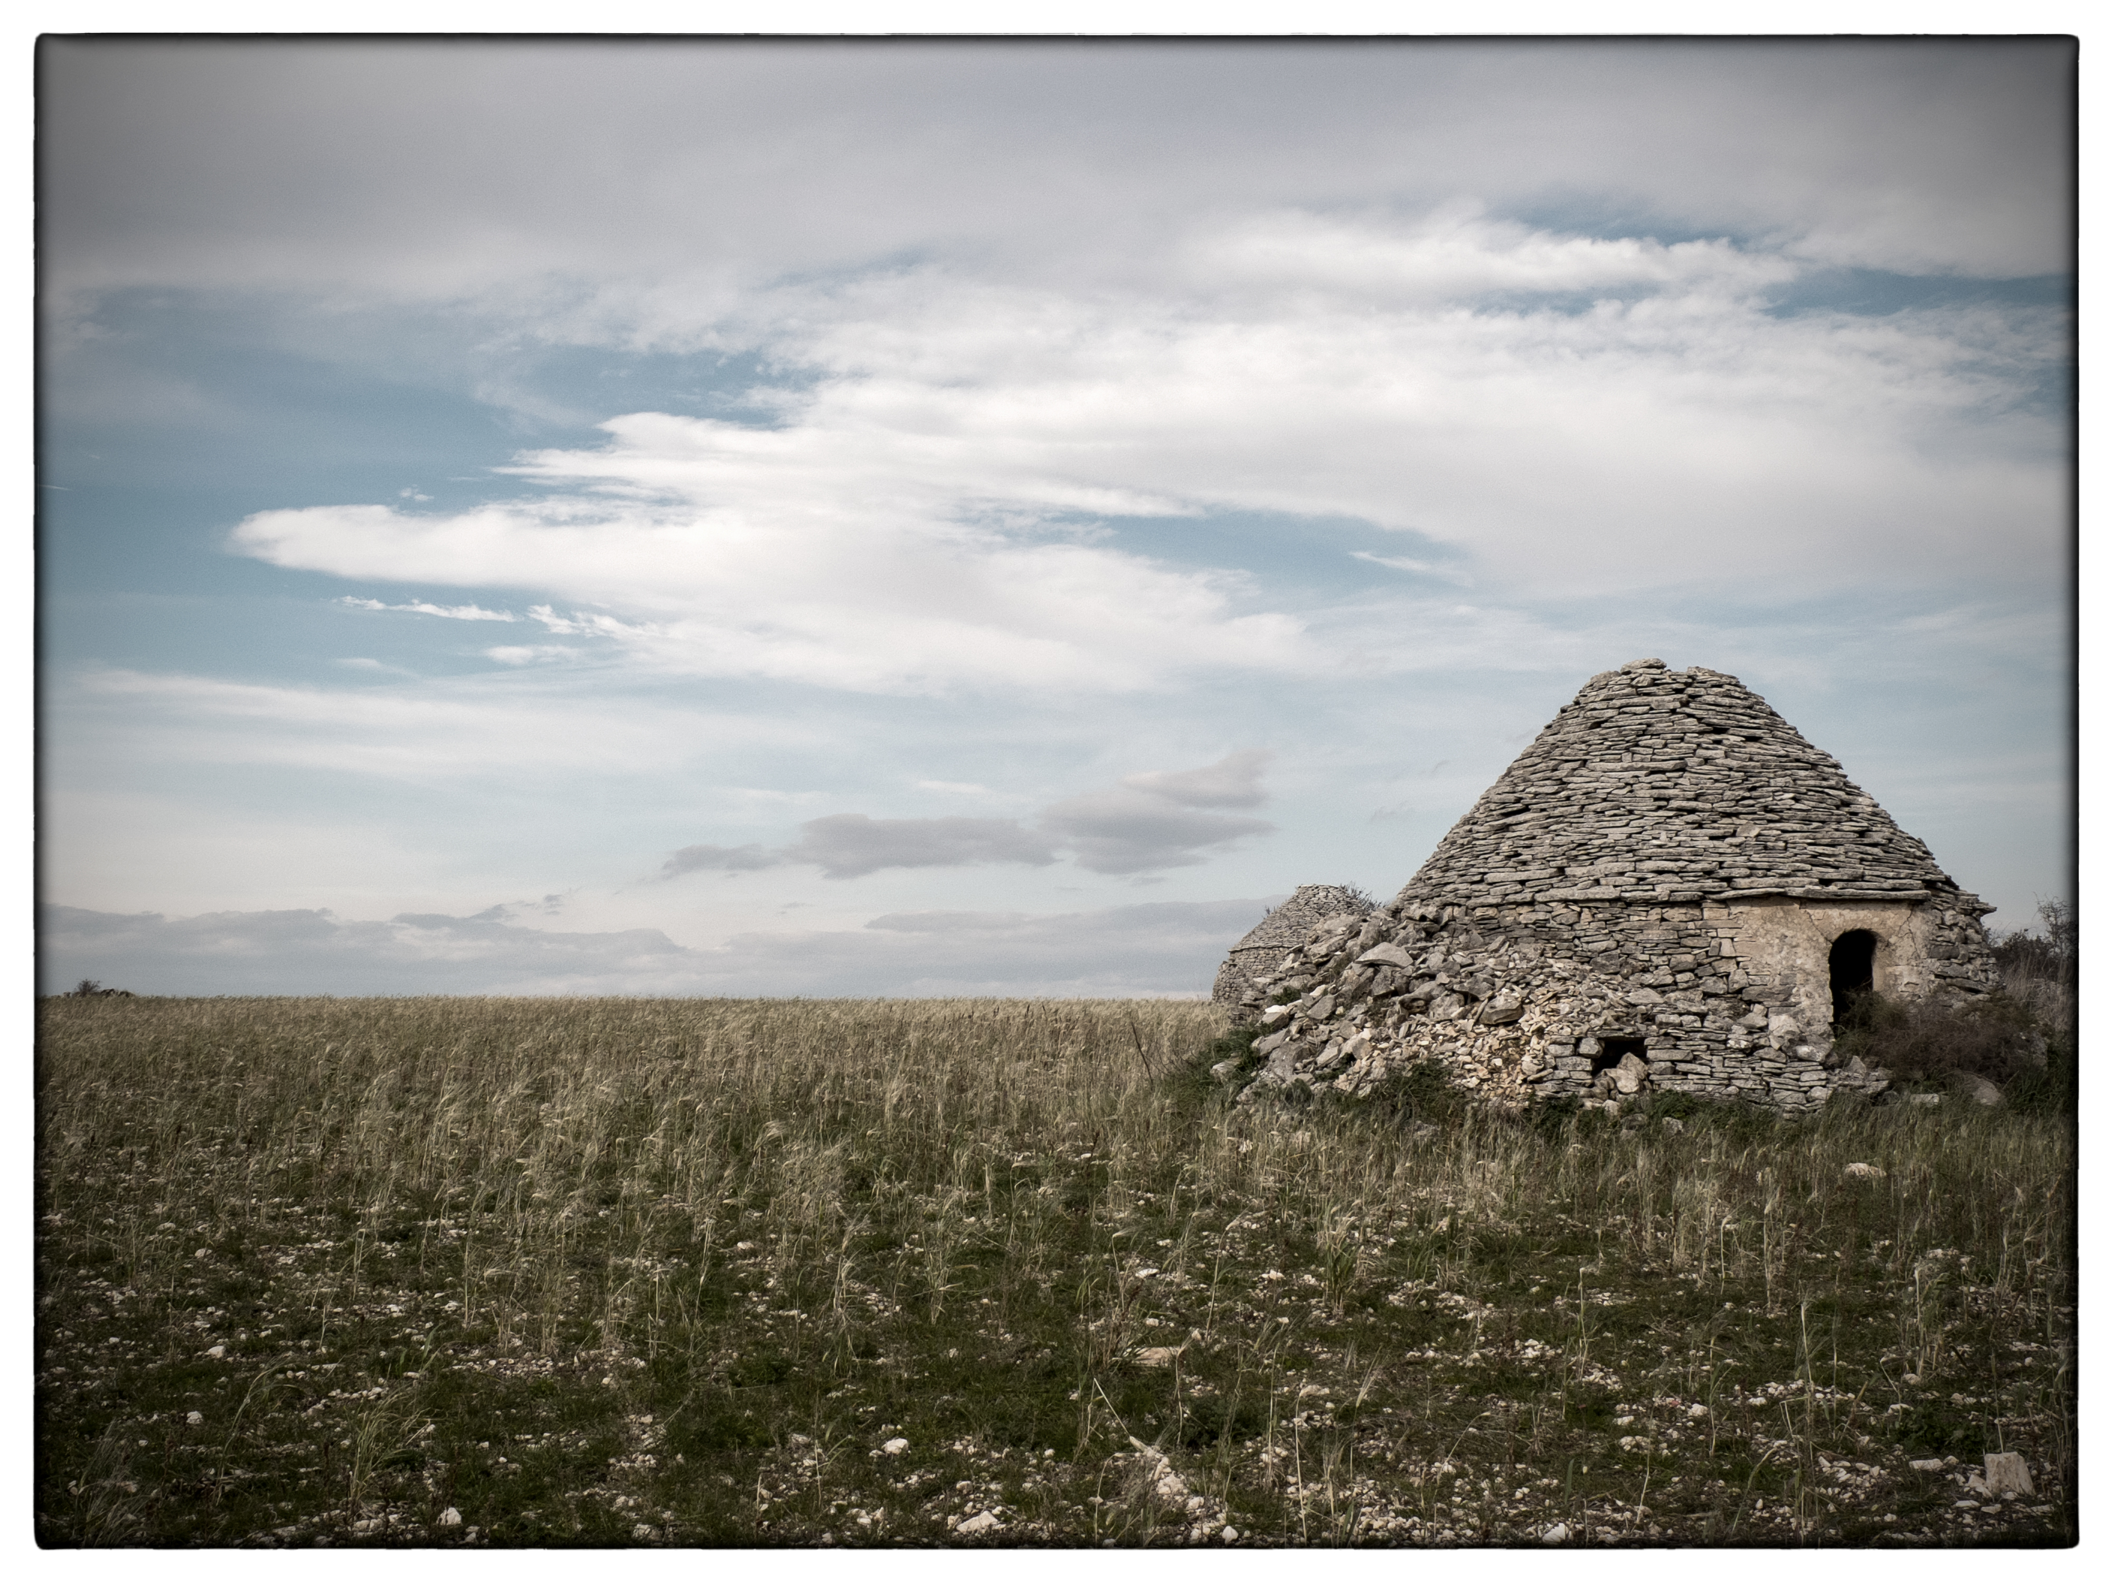
RECIPES AND TRADITIONAL APULIAN COSTUMES

Slide 2
The traditional Apulian cuisine
Puglia is a largely agricultural area in the south of Italy, famous for its olive oil and wine. It is flat and fertile with a spectacular coastline and many resorts. Vast tracts of the region's territory are given over to farming, with crops and livestock, and many inhabitants continue to grow their own produce. This essentially agricultural nature means that the region's cuisine is inspired by the local produce: wheat, vegetables and olive oil. The local durum wheat is used for local pasta specialities. Orecchiette, little ear-shaped shells that are still produced by hand on a daily basis by many housewives. It is usually served with tasty sauces such as meat ragu, broccoli and lard, mushrooms or turnip tops. A great role in the traditional Apulian cuisine is also played by legumes and fish as the region coastline overlooks the Adriatic Sea. As with pasta, the local durum wheat is also used in Puglia's delicious bread, which comes in all shapes and sizes and is a constant companion to meals. In more remote villages, communal wood-burning ovens still exist where local housewives can bake their own bread.
The local cuisine is also characterised by a wide variety of vegetables: tomatoes, artichokes, broad beans, rockets, zucchini, beans, fennel, peppers, onions. Broad beans are used to make thick soups in the winter and part of salads in the summer. They are even added to pastas and often ground into purées. Puglia cuisine makes use of wild vegetables such as broccoli. Served either alone or as part of a dish, they add a certain unique flavour which is associated with Puglia.
Puglia's rocky interior is ideal for sheep-farming and, in terms of meat, lamb, pork and beef are quite popular in our local cuisine.The presence of so many sheep also means that cheese is generally of ovine extraction. Puglia's pecorinos and ricottas are excellent and delicious as well as burrata di Andria, a fresh, soft cheese .Puglia's long coastline and fishing tradition bring large quantites of seafood to the table. Red mullet, mussels, sea bass and cuttlefish are featured in many recipes and the many seafront restaurants in towns on the Puglia's long coastline bring large quantites of seafood to the table.
Finally Puglia's desserts are very delicious. Many are almond based (the region produces vast quantities of almonds), often combined with honey or vin cotto di fichi (a kind of fig concentrate), while sweetened ricotta cheese characterises many local desserts.Because of its natural and genuine foods, made up of active ingredients that aid the prevention of some diseases such as cholesterol, stroke cancer and neurodegeneratives, Puglia cuisine is a true expression of Mediterranean diet, recognized World Heritage by Unesco in 2010.
P.s. The recipes you’ll find in the booklet are some of the many more that you can find by simply clicking on any website referring to Puglia.
All recipes are meant to serve 4 people. Enjoy them, Buon Appetito!

Slide 3
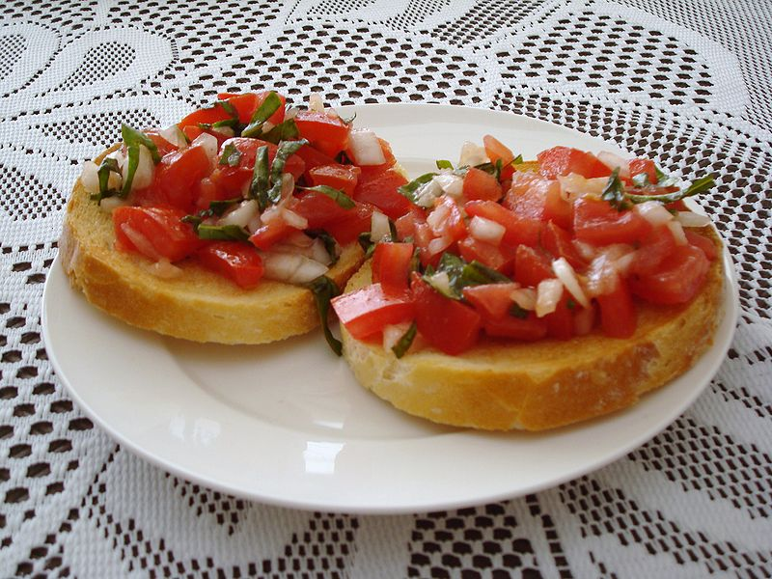
STARTERS

Slide 4
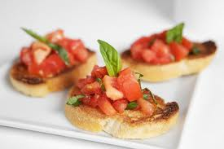
Cooking time: 15mins.
Ingredients: baguette bread, small red tomatoes, garlic clove, basil leaves, salt, fresh oregano, olive oil.
Preparation: Preheat the oven to 180° for some mins., slice the baguette bread, toast the slices in the oven until browned a little. Wash and chop the tomatoes, the basil leaves and the garlic, place them in a bowl, season with olive oil, salt and mix. Dress the slices of bread with the mixture and serve.
BRUSCHETTA

Slide 5
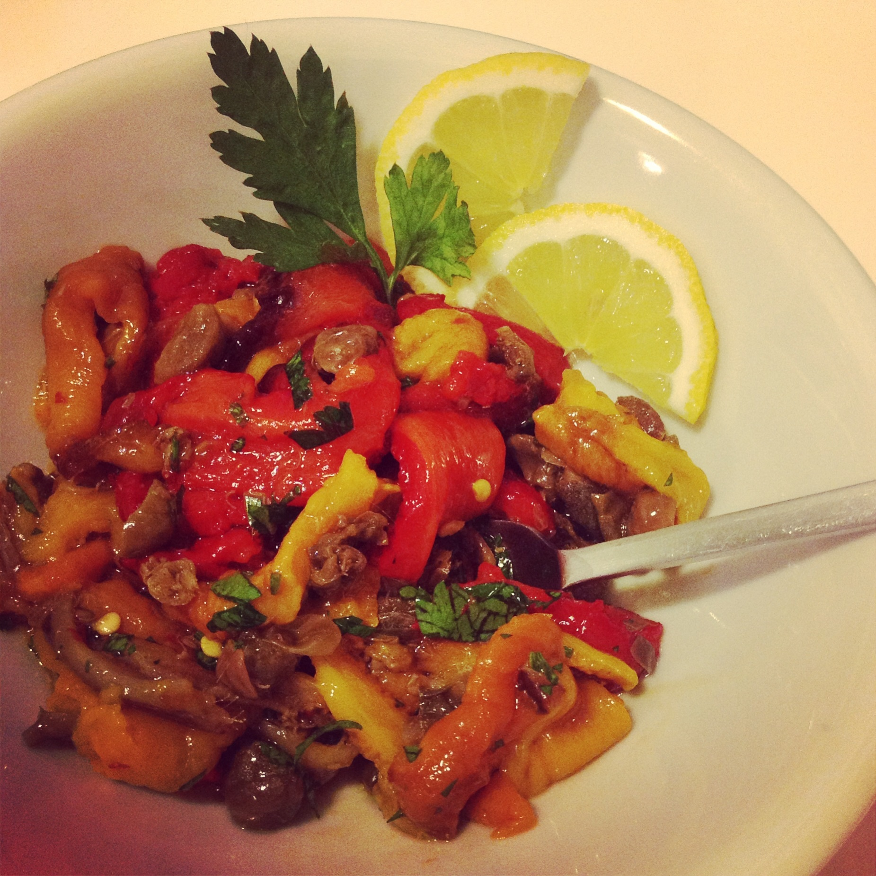
Cooking time: 30mins.
Ingredients: 3 peppers (green, red, yellow), 2 desalinated anchovies, garlic clove, parsley, olive oil, aromatic vinegar.
Preparation: Preheat the oven to 250°. When it gets very hot, wash the peppers, drain with absorbent paper, cook them in a baking tray in the oven up to 30 mins. While in the oven, turn them often so to roast on each side. When the peppers look well roasted, take them out and leave to stand for 15mins so that it is easier to peel them. Wash them quickly under running water to remove the remaining skin and the interior, drain them in a strainer for a minute or so. Cut them lengthways into stripes and dress with chopped parsley, garlic, anchovies, a pinch of salt, a drop of aromatic vinegar and serve.
ROASTED PEPPERS
WITH ANCHOVIES

Slide 6
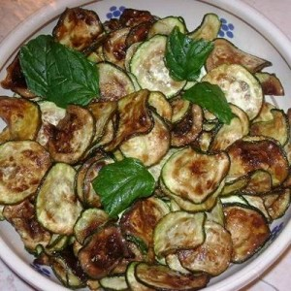
Cooking time: 10mins.
Ingredients: 5 zucchini, 1 garlic clove, parsley, salt, olive oil, 5 fresh mint leaves.
Preparation: wash the zucchini and the parsley, chop the parsley and slice the zucchini into round shape. Grease the base of a large frying pan with olive oil and the whole garlic clove. Let it brown a little then fry the zucchini, stirring often until golden browned. When ready remove the garlic clove, add a pinch of salt and the mint leaves, turn off the heat, transfer the zucchini in a serving dish.
PARSLEY ZUCCHINI

Slide 7
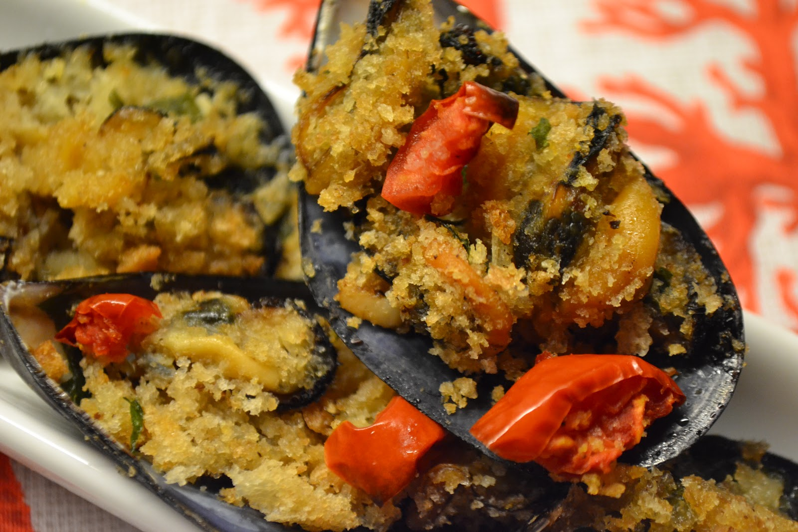
Cooking time: 20mins.
Ingredients: 1 kg mussels, 2 eggs,50gr. breadcrumbs, 30gr. grated parmesan cheese, 30gr. parsley, olive oil, pepper.
Preparation: Brush and wash the mussels under running water. Open the mussels and remove the empty half of the valve. Keep the liquid of the mussels and filter it. Grease the baking pan with olive oil, arrange the mussels forming an only layer and top with a little oil. Mix the eggs, breadcrumbs, grated parmesan, chopped parsley , a pinch of salt and a little pepper in a bowl. Fill each mussel with the mixture, add some filtered liquid and oil. Preheat the oven to 180°, turn it to grill function, place the baking tray in the oven and cook for about 10/15 mins. until the top is golden brown. Serve them warm.
STUFFED MUSSELS
AU GRATIN

Slide 8
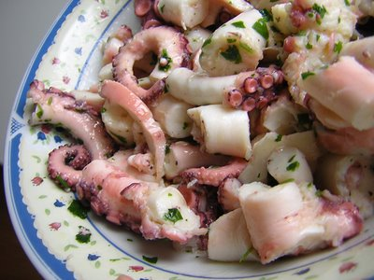
Cooking time: 40mins.
Ingredients: 1 kg octopus, 3 garlic cloves, 1 carrot, 1 celery, 2 bay leaves, capers, parsley, 4tblsps.olive oil, 1 lemon juice, salt, pepper.
Preparation: Fill a pan with water, add the carrot, celery, 2 garlic cloves, bay leaves, bring to a boil. Wash the octopus under running water and put it in the pan with the lid on over a low heat up to 40mins. Check that the octopus has softened, take it out of the pan. Place it on a cutting board and start chopping. Transfer it into a bowl, dress it with olive oil, chopped parsley, 1 crushed garlic clove, capers, salt, pepper and the lemon juice. Top with a chopped lemon and serve either warm or cool.
OCTOPUS SALAD

Slide 9
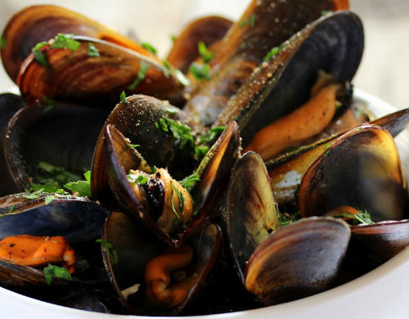
Cooking time: 30mins.
Ingredients: 2Kg mussels, a handful of parsley, 2 garlic cloves, half glass white wine, 15a pinch of chilli pepper, 5 small red tomatoes, 2 tblsps. olive oil, pepper.
Preparation: clean and wash the mussels thoroughly under running water. Fry the garlic, chilli pepper, chopped parsley with a bit of olive oil in a large pan mixing the ingredients for 5 mins. Drain the mussels in a strainer, put in the pan, cook up to 10mins with the lid on over a medium heat. Then, pour half glass wine, let evaporate, add the chopped tomatoes, cook for 10mins. more. Turn off the heat, transfer into a serving dish, top with some more parsley, pepper and serve.
PEPPERY MUSSELS

Slide 10
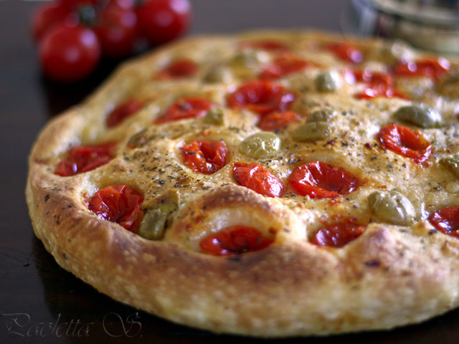
Cooking time: 20mins.
Ingredients: 200gr. durum wheat flour, 300gr. plain flour,200gr. baker’s yeast, 10gr. salt, 1(100gr.)potato 100gr., 50ml.olive oil, 300/350ml.water, 400gr. small red tomatoes, 20 black or green olives, dried oregano.
Preparation: First, have the potato stewed, peeled and mashed. Pour both the durum wheat flour and the plain flour into the processor, add the mashed potato, salt, yeast , add a bit of water(at room temperature) then activate the processor to low speed and add the remaining water little by little, slowly. Then, add the oil. After 5mins,speed up the processor and continue kneading the dough for 15mins. more until the dough detaches itself from the sides of the processor and bubbles . It should look smooth and bouncy. Add just a bit of flour if you see that the dough doesn’t separate from the sides. Once the dough is ready, put a bit of oil in a baking tray and place the dough into it, turn it on each side to grease it. Knead the dough to make 2 round balls of 400gr. each and leave them to stand side by side so that it helps rising for about 8/12 hours. If the room temperature is 20° the dough will rise in about 8h. If it is between 15°-20° it will need 12h. When time has come and you’ve noticed a light crust on the top of your dough, that means that the rising process has occurred successfully. Anyway, to make sure that this is the case, press lightly the top with your finger. The dough should return to its initial shape automatically. Now it’s time to bake your focaccia. First, grease a 32cm round baking pan with olive oil, place the dough in the middle, turn it on both sides to grease and spread over the base with your hands to line the dough to the base of the baking tray. Wash and squeeze the tomatoes on the dough so that the seeds and water come out and arrange them upside down. Spread the olives random, add a pinch of salt and dried oregano. Repeat the procedure with the other dough ball. Preheat the oven to its maximum temperature, bake for 20mins. to 250°/270°. When ready, the focaccia should be 1-1,50cm high and look crunchy. Let it stand 5mins before serving.
FOCACCIA

Slide 11
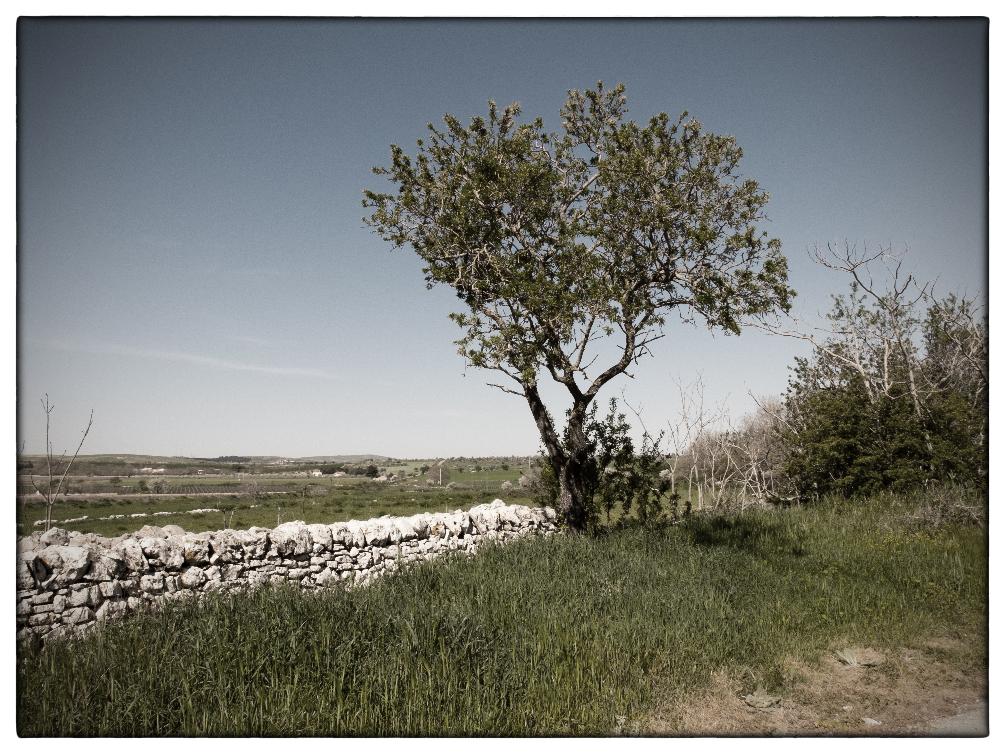

Slide 12
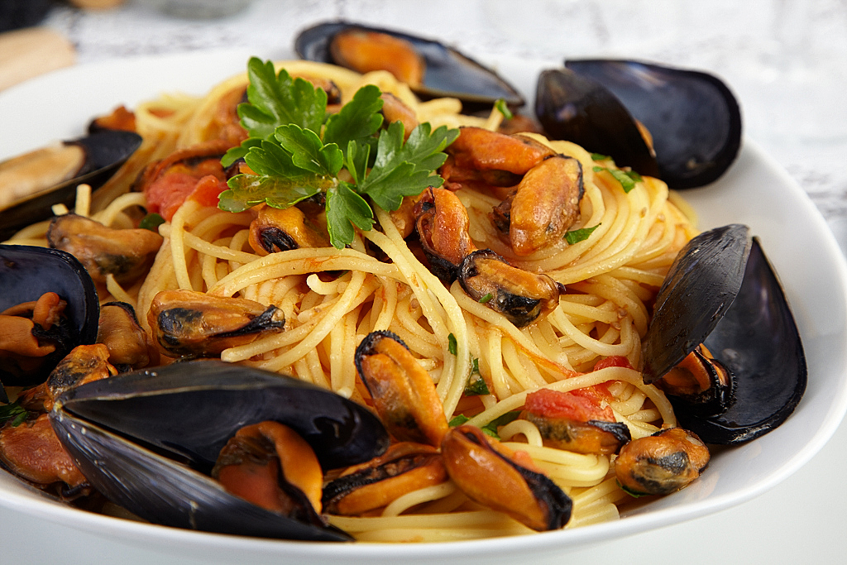
FIRST COURSES
FIRST COURSES

Slide 13
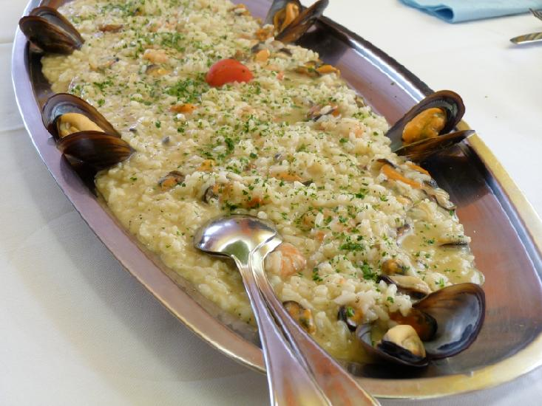
Cooking time : half an hour
Ingredients: 350g. rice; 800g. calamari, squids, mussels, clams, shrimps, 1 onion, 1 garlic clove, 1glass of white wine, 250g.peeled tomatoes, olive oil.
Preparation: Brown the ground onion and the garlic in hot olive oil. Add the mixed seafood (calamari and squid need to be sliced) and fry, stirring a few times. Add the wine and let evaporate. Cook for about 5/7 minutes. In another saucepan bring 1lt of water to a boil, then add the fish stock cube and let it melt. Add the rice to the seafood, stirring for 5 mins. Join the tomatoes, salt and pepper. Cook for 20mins, adding warm water until it reaches the cooking time. When ready top with ground parsley and serve.
RISOTTO
WITH SEAFOOD

Slide 14
SPAGHETTI OR LINGUINE WITH MUSSELS
Cooking time: half an hour
Ingredients: 500gr. spaghetti, 1Kg. mussels with the shells, 1 garlic clove, red chili pepper, olive oil, parsley, salt, 1 glass white wine.
Preparation: Brown the garlic and the red chili pepper into the olive oil, add the well washed mussels and cook for 10mins at moderate heat. When all the mussels are open pour the wine and let evaporate. Cook 10mins more at low heat. Boil the spaghetti in salted water. Drain spaghetti and mix with the mussels sauce. Top with ground parsley, a little olive oil and serve.

Slide 15
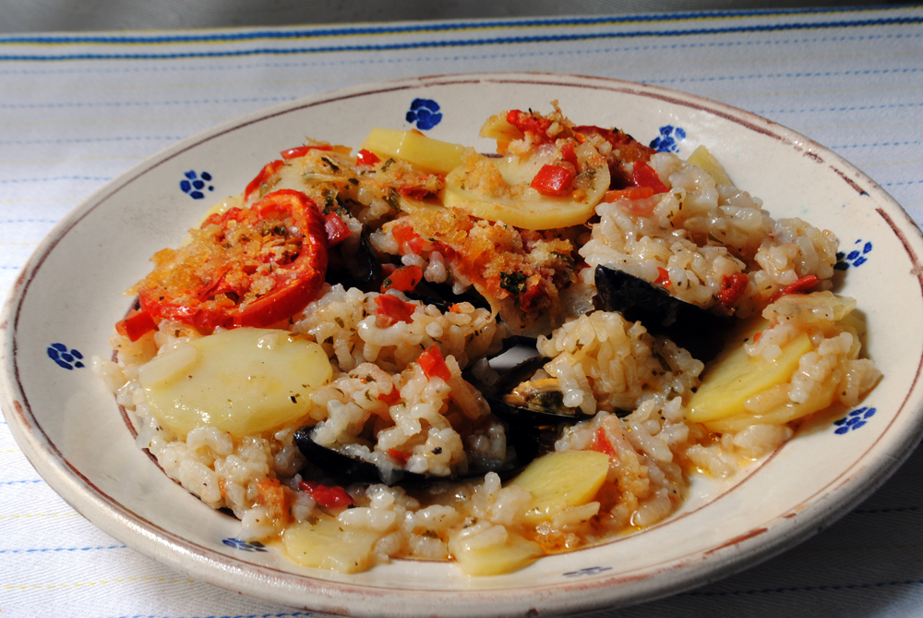
RICE WITH MUSSELS AND POTATOES
Cooking time: 1 h.
Ingredients: 250gr. rice, 1Kg mussels without shells, 5 potatoes, 4 red tomatoes, 1 garlic clove, 1 small onion, salt, pepper, parsley, grated parmesan cheese, 1 level tablespoon olive oil.
Preparation: cut the potatoes into slices and place some of them into a baking tray and season with salt, grated parmesan and 2 chopped tomatoes. Cover with a layer of mussels (previously well washed) add the rice and season with salt, parmesan cheese, 2 more chopped tomatoes, olive oil. Cover with another layer of the remaining sliced potatoes and season again with salt, oil and parmesan cheese, then cover the whole with water. Preheat the oven to 160° and put the baking tray into it. Let it cook for about an hour. Take it out when the top browns. Leave to stand for 5mins before serving.

Slide 16
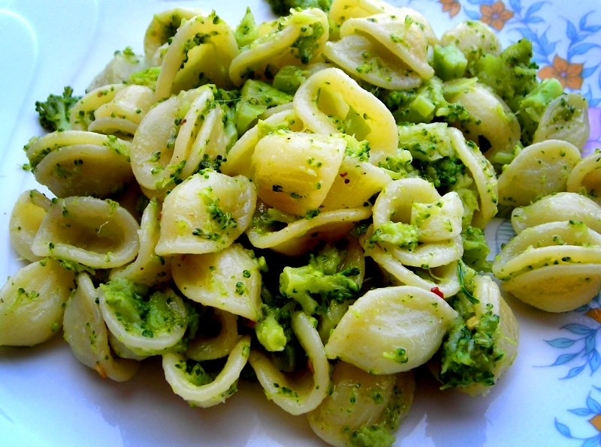
Cooking time: 30mins.
Ingredients: 300gr orecchiette, 1/2kg broccoli, 4 anchovies, red chili pepper,garlic,salt,5 tblsps olive oil.
Preparation: wash and cut the broccoli into small florets, put them into a boiling water until the vegetables have softened then pour the orecchiette and let them cook together for about 10mins more. While the pasta is cooking, put the olive oil, garlic, red chili pepper (as much as you like) and the anchovies into a frying pan, stir for 1mn. Drain the broccoli and the orecchiette and pour them into the frying pan,mix with the anchovies sauce and serve.
ORECCHIETTE WITH BROCCOLI

Slide 17
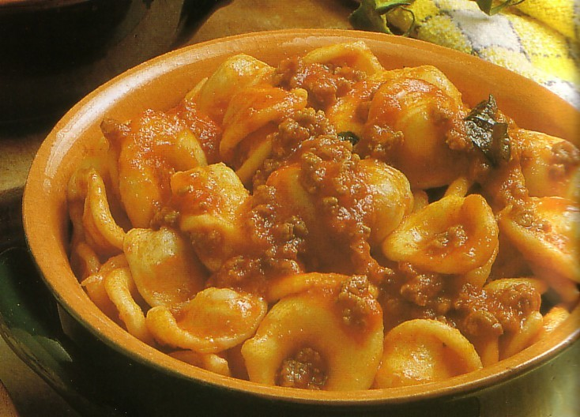
ORECCHIETTE WITH RAGÙ SAUCE
Cooking time: about 2h
Ingredients: 500gr orecchiette, 400gr beef (chopped beef or any other kind of meat), 200gr sausages,1 lt tomato purée,2 onions, 2tbsp olive oil, salt, 1 glass white wine, 150gr grated pecorino cheese.
Preparation: Put the olive oil into a large pan, add the onions finely chopped and cook over moderate heat until they get soft then add the chunks of beef and a pinch of salt and let it cook with the lid on for about 15mins more. Stir it well, add a glass of wine and let it evaporate. Add the tomato purée and let it cook without the lid for about 2 hours over low heat. Stir the sauce every half hour. Halfway the cooking add the sausages cut into pieces. The ragù will thicken considerably during this phase and that is how it is meant to be. If it starts to stick to the pan, add some wine and go on stirring. About 10mins before the ragù is ready, bring to a boil the orecchiette, drain and place them onto a serving dish. Take the chunks of beef and the pieces of sausages out of the pan with pincers and transfer onto a serving dish. Pour some sauce on the orecchiette, stir, add some grated pecorino. Top with some more ragù and pecorino.

Slide 18
BROAD BEANS AND CHICORY
Cooking time: 20mins.
Ingredients: 300gr. Dried broad beans without skin, chicory ( any other kind of long leaf vegetables are ok), olive oil, salt.
Preparation: put the dried broad beans in a large bowl filled with water and leave them for at least 2h. Then put them in a large pan and bring to a boil over low heat, salt the water and cook for about 20mins until they have softened and looked like a purée. Once they have cooked, turn off the heat, add some olive oil and stir well with a wooden spoon. Now prepare the vegetables. Take the roots out of the vegetables, wash them well and put them into boiling salted water, cook for 7mins. Drain the vegetables and place them into a serving dish, add 2 tblsp of broad beans, top with a little olive oil and serve.

Slide 19
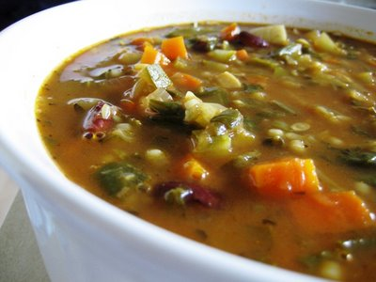
MINESTRONE
Cooking time: 1h 20mins.
Ingredients: 1 zucchini, 50gr.cauliflower, 50gr. cabbage, 1 carrot, 2 potatoes, 1 onion, 6 small red tomatoes, 100gr. peas,100gr. beans, 1 celery, small chunks of pecorino cheese, grated parmesan cheese, basil, olive oil, salt, pepper.
Preparation: chop all the vegetables into small pieces, put the vegetables in a large pan and fill it with enough water to cover the vegetables, add the pecorino, salt and pepper and cook for about 2h. at low heat. Then, serve the minestrone topping it with a little olive oil and some grated parmesan cheese.

Slide 20
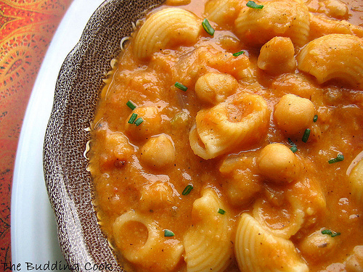
SMALL PASTA WITH CHICKPEAS SOUP
Cooking time: 2h.
Ingredients: 300gr. chickpeas, 1 carrot, 1 celery, 1 garlic clove,1 onion, 3 small tomatoes, rosemary, olive oil, salt, pepper, chili pepper.
Preparation: put the chickpeas in a large bowl full of water and leave them to soften all through the night. Drain and wash them under running water, add to the vegetables previously chopped, into a large pan and start cooking for almost 2h over medium heat. Just before turning off the heat, remove the garlic, squash the celery and carrot, add a pinch of salt, and a bit of chilli pepper in powder. Apart, bring the small pasta (any kind would be fine) to a boil then drain it. Mix the pasta with the chickpeas soup add some pepper and serve it.
P.S. An alternative to chickpeas can be any other type of legumes i.e. beans, lentils, dried peas, broad beans, etc.

Slide 21
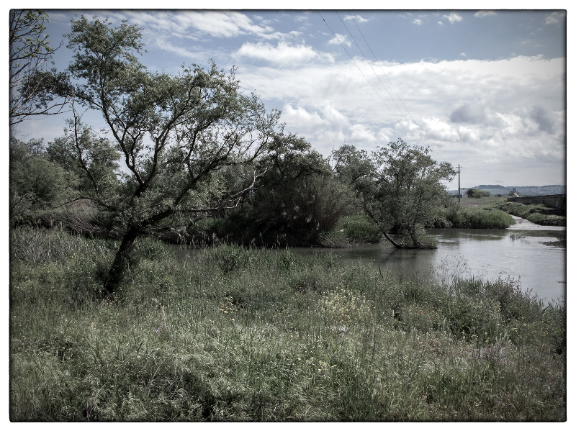

Slide 22
SECOND COURSES

Slide 23
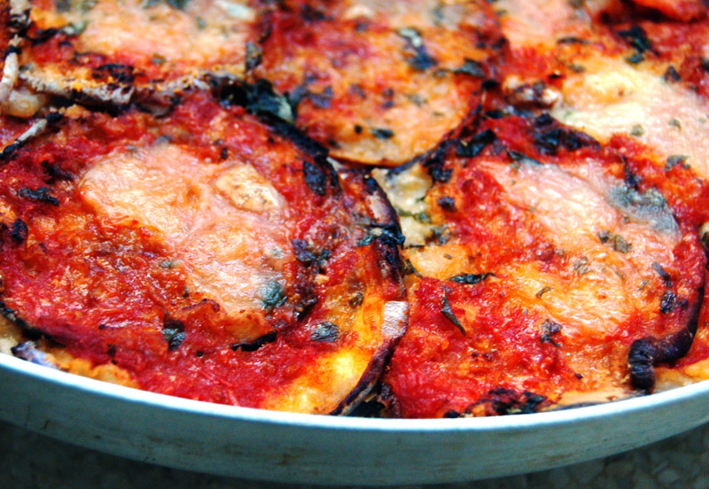
PARMIGIANA
Cooking time: 2h.
Ingredients: 4 round aubergines, 100gr. plain flour,4 eggs, 1 onion, 500gr. tomato purée, 300gr. mozzarella cheese, 200gr. sliced bologna or any other salami, 100gr. grated parmesan cheese, olive oil (in alternative peanut oil), basil, parsley, salt.
Preparation: Peel the aubergines then slice them finely (about 1/2 cm thick), place them in a strainer, sprinkle some salt on them to lose the bitter of their water, drain on absorbent paper carefully. Then prepare the mixture you’ll need to fry the eggplants. Put some flour in a dish, lightly beat the egg and yolk in another dish. Fill a large frying pan with oil and let it get hot over a medium heat. Dip the aubergine slices first in the flour then in the eggs batter and fry them on both sides until browned lightly. Transfer the fried slices to a plate where you’ve placed absorbent paper. Apart, prepare the tomato purée. Put some olive oil, a finely sliced onion in a saucepan and let it fry a bit, add the tomato purée, 3 basil leaves, some salt and cook, stirring often for 15mn. Once the sauce is ready, spread it over the base of a rectangular baking tray with the back of a wooden spoon then line the slices so to cover the base, put some slices of bologna, chopped parsley, chopped mozzarella, some more tomato sauce and top with grated parmesan. Repeat the procedure with two more layers of aubergines. Bake for 30mn to 200°. A few minutes before you take it out, turn to the grill function until to have it topped brown and taste crispy. Before serving, leave it to stand for some minutes.

Slide 24
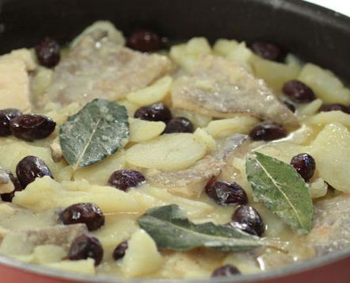
COD WITH TOMATO SAUCE AND BLACK OLIVES
Cooking time: 30mins.
Ingredients: 8 pieces cod, 4 tomatoes, 100gr.plain flour, 20 black olives, 1 garlic clove, olive oil, 1 onion, parsley.
Preparation: wash the cod, drain on absorbent paper carefully then put some flour onto a dish, some oil in a frying pan and let it get hot enough. Dip the pieces of cod into the flour, draining excess and fry the cod at medium heat until browned lightly. Remove the cod from the heat and turn it down. Chop the parsley, garlic and the onion. Let the mixture fry on low heat for a minute. Add the chopped tomatoes, the black olives, a pinch of salt and cook for 5mins at medium heat. Finally, add the cod, spread some tomato sauce on the cod and cook with the lid on for 5mins more. Top with a little olive oil and serve.

Slide 25
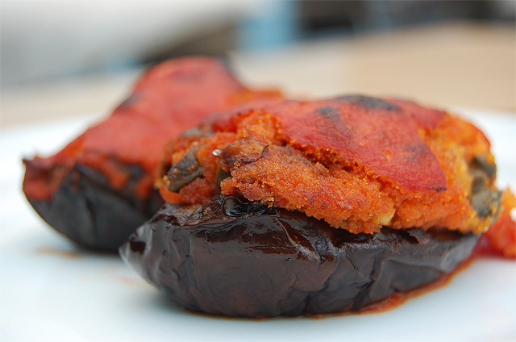
STUFFED AUBERGINES
Cooking time: 30mins.
Ingredients: 2 long aubergines,2 eggs, 100gr.breadcrumbs, 2tblsp grated pecorino cheese, parsley, basil, garlic, 6 tomatoes, olive oil, salt, vinegar.
Preparation: wash and cut the aubergines into 2 halves lengthways, bring to a boil the water in a large pan ,salt it and pour a tablsp of vinegar in it. Cook the halves in the boiling water for 5mins. Remove the interior of the aubergines, chop it and put into a large bowl. Heat some olive oil in a frying pan, brown the ground garlic. Add the aubergine mixture and cook with the lid on for 15mins. Transfer in the bowl, add some breadcrumbs, beaten eggs, grated pecorino and parsley. Fill the aubergines with the mixture. Apart in another frying pan prepare the tomato sauce: put some oil, chopped tomatoes, garlic, a pinch of salt and cook for 5mins. Once the tomato sauce is ready, add some fresh basil leaves. Then place the stuffed aubergines in a baking tray. Spread the tomato sauce just cooked on them, top with olive oil and bake to 200° for about 20mins. Leave to stand for 10mins before serving.

Slide 26
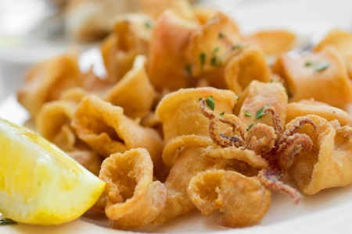
MIXED FRIED FISH
Cooking time: 30mins.
Ingredients: 4 small red mullets, 4 small soles, 6 fresh small anchovies,4 small cods, 3 squids, 4 prawns, 4 small lobsters, 200gr. flour, peanut oil, 3 lemons.
Preparation: remove the interior of the fish selected except for prawns and lobsters. Chop the squids into small pieces. Wash all the fish carefully, drain on absorbent paper. Heat the vegetable oil in a large frying pan, dip the fish into the flour and drain excess. Fry the fish until browned lightly then drain on absorbent paper and place it on a large serving dish. Serve with chopped lemon and fresh salad.

Slide 27
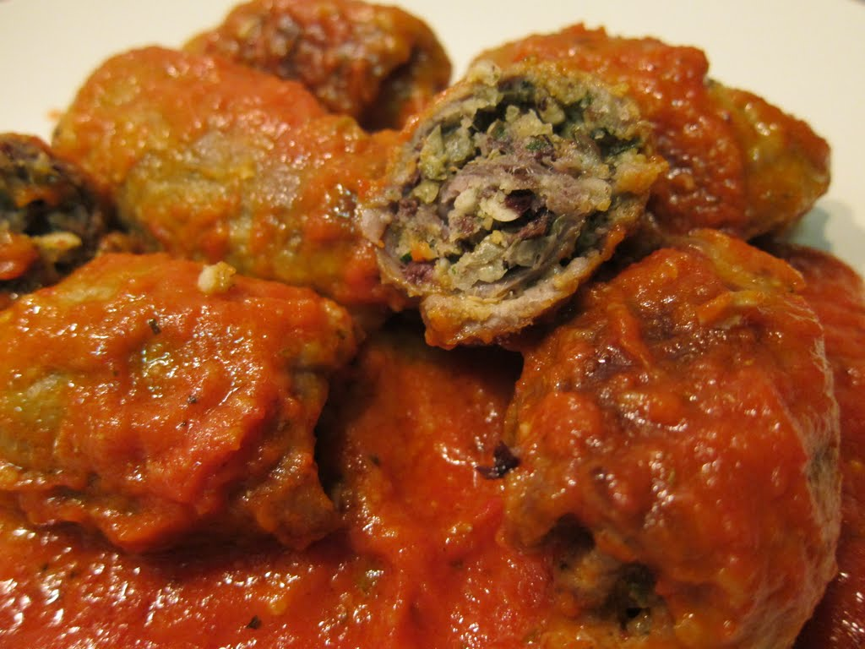
BEEF ROLLS WITH RAGÙ SAUCE
Cooking time: 1h.30mins.
Ingredients: 6 minute steaks beef, 120gr. grated pecorino cheese, 50gr. flour,2 glasses of ragù, 250gr.ham,1 garlic clove, parsley, olive oil, salt, pepper, 1 glass red wine, 1 carrot, half celery, 1 onion, 1 bay leaf.
Preparation: Pound the slices of beef with a meat hammer and season with salt and pepper. Line them on the kitchen table and start stuffing them in the middle with chopped garlic, parsley, ham and grated pecorino. Roll them tightly so to keep the stuffing inside and tie them up with a sewing string. Put some olive oil in large saucepan, add 1 finely chopped onion, carrot, celery, the bay leaf, cook at medium heat until lightly golden. Roll the beef rolls into the flour and drain excess. Place the rolls in the saucepan over high heat, add red wine, the ragù sauce, previously prepared, 2 glasses of water to cover the rolls, a pinch of salt and pepper. Bring to a boil and continue to cook for 1h.30mins over moderate heat stirring often. In case the sauce thickens too much, add some more water. When ready, take out the rolls with the pincers, transfer on a serving bowl, top with ragù sauce and serve with mashed potatoes.

Slide 28
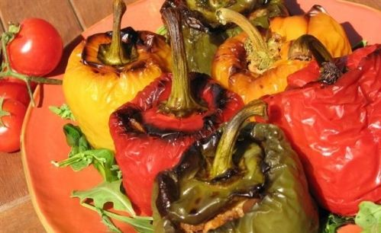
STUFFED PEPPERS
Cooking time: 1h 30mins.
Ingredients: 4 medium size peppers (red and yellow),300gr.chopped peeled tomatoes, 50gr. black olives,25gr. capers, 100gr. grated pecorino, 1 garlic clove, parsley, 50gr breadcrumbs, 3 potatoes, olive oil, salt, chili pepper.
Preparation: wash the peppers carefully, drain and cut them into halves, remove the interior, cut the top part into pieces( you’ll need it for the stuffing). Boil the potatoes in a saucepan until tender, peel them and mash until smooth. Fry the garlic in the oil in a large pan until browns and remove it. Fry the chopped peppers, add the peeled tomatoes and a pinch of salt, cover and cook up to 15mins. Remove the peppers from the heat, put in a large bowl, add breadcrumbs, grated pecorino, chopped parsley, mashed potatoes, capers and the olives without the kernel. Mix all ingredients and fill the peppers, pressing lightly the mixture inside the peppers. Transfer in a large baking pan, season with oil, the remaining chopped tomatoes, salt, chili pepper and bake for 60mins. Serve it either warm or cool with steamed vegetables of your choice.

Slide 29
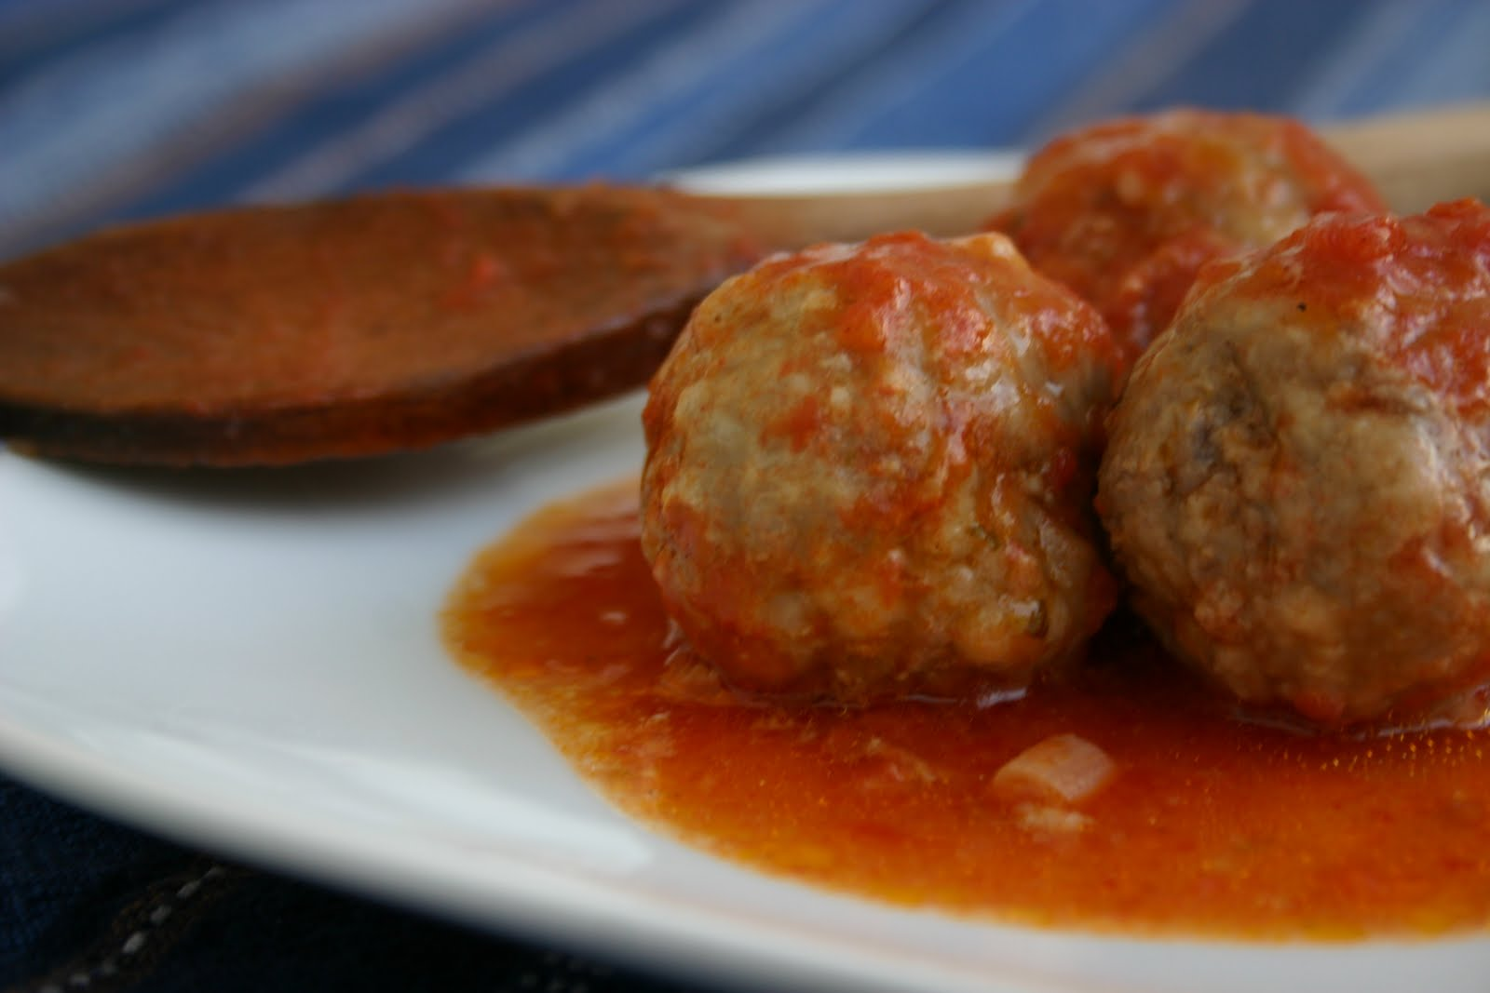
BEEF MEATBALLS
Cooking time: 45mins.
Ingredients: 500gr. minced beef or pork, 1 small onion, 3 crushed garlic clove, 3 eggs, 100gr. fresh breadcrumbs, a pinch nutmeg, 4/5 fresh basil leaves, 50gr. grated parmesan cheese, 50gr. grated pecorino cheese,5tblsps.olive oil, 1lt. tomato purée, salt, pepper, parsley.
Preparation: First make the bread into crumbs in a processor, put in a large bowl, add the minced meat, parmesan cheese, pecorino cheese, salt, pepper, nutmeg, parsley, eggs. Mix all ingredients with hands and leave the mixture to stand for an hour. Meanwhile make the tomato sauce. Heat the oil in a large pan, chop the onion and garlic finely and fry over a low heat up to 15mins, pour the tomato purée, add a pinch of salt and bring to a boil. Return to the meat mixture and start shaping it into 12 meatballs. As soon as the tomato sauce is ready, transfer the meatballs carefully into the pan, shake it gently to allow them to stand. Cook for 20/30mins more over a low heat. Five mins. before turning the heat off, add the basil leaves. When ready, top with tomato sauce.

Slide 30
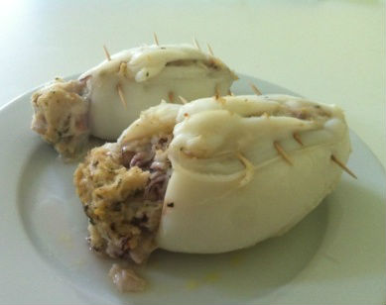
STUFFED CUTTLEFISH
Cooking time: 60mins.
Ingredients: 1kg medium size cuttlefish, 4 desalinated anchovies, 50gr, chopped parsley, 2 tablsps. capers, 1 garlic clove, 100gr. grated pecorino, 2 eggs, 300gr. fresh bread, 2 tablsps. olive oil, salt, pepper.
Preparation: wash the cuttlefish thoroughly, remove the interior but keep the heads. Put the bread in a bowl filled with water and leave it to soften. Squeeze the bread to remove the water, drain excess and put it in a bowl. Add the eggs, the anchovies, ground parsley, grated pecorino, capers, salt and pepper. Mix all ingredients so to get a smooth mixture and start stuffing the cuttlefish. Tie them up with 3 toothpicks each or a sewing string firmly. Put the olive oil in a baking tray, place the stuffed fish and bake in the oven to 180° for 40mins. Serve with steamed potatoes.

Slide 32
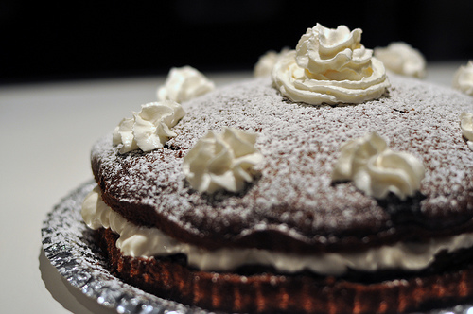
DESSERTS

Slide 33
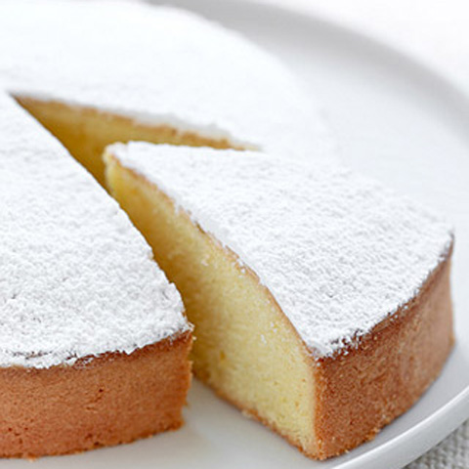
DAISY SPONGE CAKE
Ingredients: 150gr. plain flour, 70gr.butter,16gr.baking powder, a pinch of salt, 4 eggs, 120gr.potato flour,150gr. sugar, half glass milk, 1 lemon, icing sugar.
Preparation: preheat the oven to 180° then grease and dust with flour the baking tin. Separate the egg yolks from the whites and beat the latter adding a pinch of salt. In a different bowl beat the egg yolk with the sugar, add the butter and mix well. Slowly add the flour , potato flour and the baking powder previously sieved . When they are well mixed, add milk and grated lemon peel. Finally, add the egg whites, mix slowly and pour the mixture into a 28/30cm greased and floured baking tin. Bake it to 180° for about 50mins. Take it out and dust with icing sugar.

Slide 34
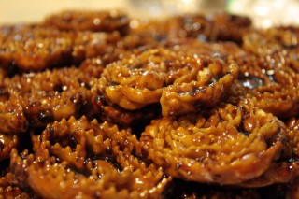
CARTELLATE
Ingredients: 1kg. plain flour, 4 glasses white wine,1lt cooked must (a kind of fig concentrate), 2 glasses olive oil, a pinch of salt, a pinch of ground cinnamon, ground cloves.
Preparation: on a wooden board pour the flour, 2 glasses of olive oil,4 glasses of white wine, a pinch of salt and start kneading the dough with your hands until it gets soft and thick. Cut the dough in a half and start rolling it out. Try to get it just under half a cm thick, then cut into 4cm wide and 30cm long strips. Fold each strip in half lengthways, make a round shape of it and roll it as a snail. Press the dough accurately so that each round strip doesn’t unfold. Let them dry on the board for about 12h. Then fry them in hot olive oil. When browned, turn them upside down and transfer on a dish where you’ve placed absorbent paper to drain the oil. Heat the must in a saucepan and dip 4 or 5 of them at a time, cook on a low heat for about 2/3mins. Drain them first, then transfer in a serving dish. Top with ground cinnamon, clove and serve.

Slide 35
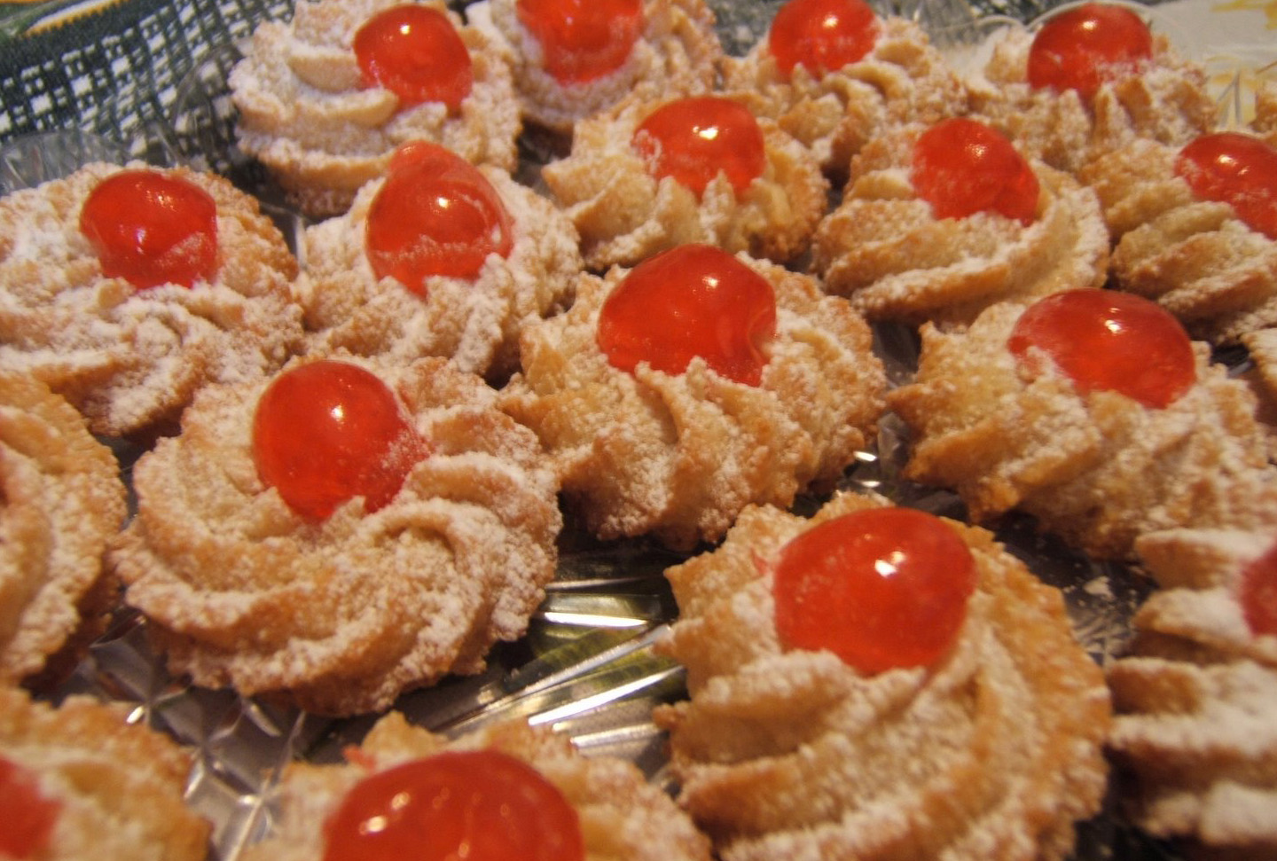
ALMOND COOKIES
Ingredients: 1kg. almonds,1kg. sugar, 5 eggs (just the whites), 2 lemons zest, 150gr. candied fruit, 150gr.coffee beans.
Preparation: bring to a boil water in a large saucepan, pour the almonds, cook for 5mins. Drain and peel them off. Leave them to dry on a wooden board for 12h. Preheat the oven to 200° and toast the almonds for about 20mins. Let them cool, make them into crumbs in a processor, add sugar. Put the mixture in a large bowl, add the egg whites. Stir the mixture until the pastry gets soft and thick, add the ground zest and continue stirring the mixture. Cut out the pastry to make 4/5cm round little cookies. Line them in a baking tray with baking paper on the base. Bake for about 30mins until the edges are golden brown. Top each cookie with a coffee bean or candied fruit and serve.

Slide 36
Ingredients: 200gr. plain flour, 200gr. sugar, 75gr. bitter cocoa, 3 eggs, 100g. olive oil, 200ml.milk, 16gr. baking powder, 250gr.mascarpone cheese,250gr. nutella cream.
Preparation: Beat the eggs in a bowl, add flour, sugar, bitter cocoa. Mix the ingredients well, starting from the centre of the bowl to its sides, add olive oil, milk, baking powder. Stir until you get a smooth mixture. Pour the mixture in a 30cm cake tin where you’ve previously spread butter to grease and some flour. Preheat the oven to 180° and bake the cake for 30mins. Meanwhile prepare the cream. Mix the mascarpone cheese and the nutella in a bowl and stir it until smooth. Once the cake is ready, leave to stand for 10/15mins. Cut the cake in half lengthways, spread the cream mixture on the base of the cake and cover with the other half. Top with icing sugar and serve.
MORETTA CAKE

Slide 37
ALMOND NOUGAT
Ingredients: 500gr. blanched almonds, 500gr.sugar,100gr.olive oil, vanilla essence or ground cloves.
Preparation: spread the almonds random in a baking tray and toast them in preheated oven for 7/8mins until light golden. Set aside for 5mins to cool. Chop them and put in a bowl. Put the sugar in a medium pan over medium-low heat, stir with a wooden spoon, brushing down the sides of the pan occasionally with a pastry brush dipped in warm water until the sugar melts( it will take about 10 mins). Quickly add the chopped almonds. Mix the pastry accurately, add vanilla essence or ground cloves. When all the melted sugar entirely wraps the almonds, remove the pastry from the pan and transfer on a cutting board. Use a serrated knife in a sawing motion to cut the nougat crossways into 3cm wide pieces, then cut each piece into about 4cm lengths. Place the nougat in a clean, dry, airtight container, separating each layer with non-stick baking paper. Leave to stand and serve.

