Slide 1
Galați
Celebrating the winter holidays !

Slide 3
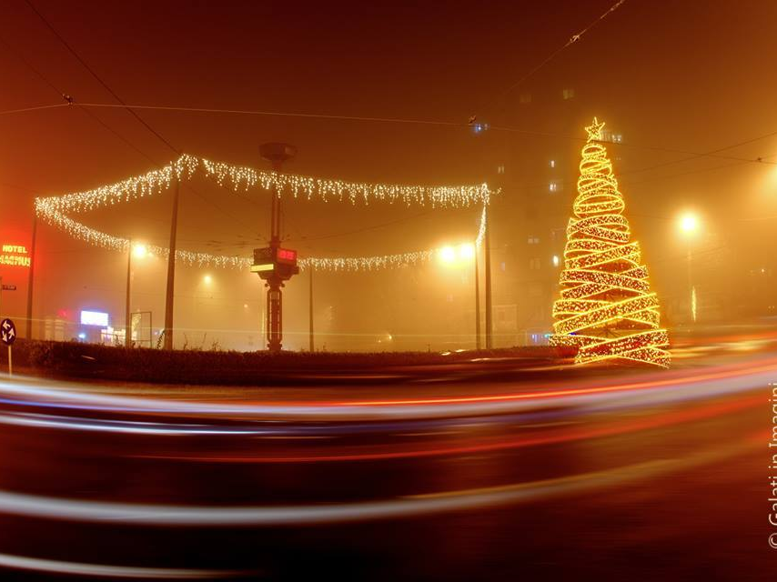

Slide 4
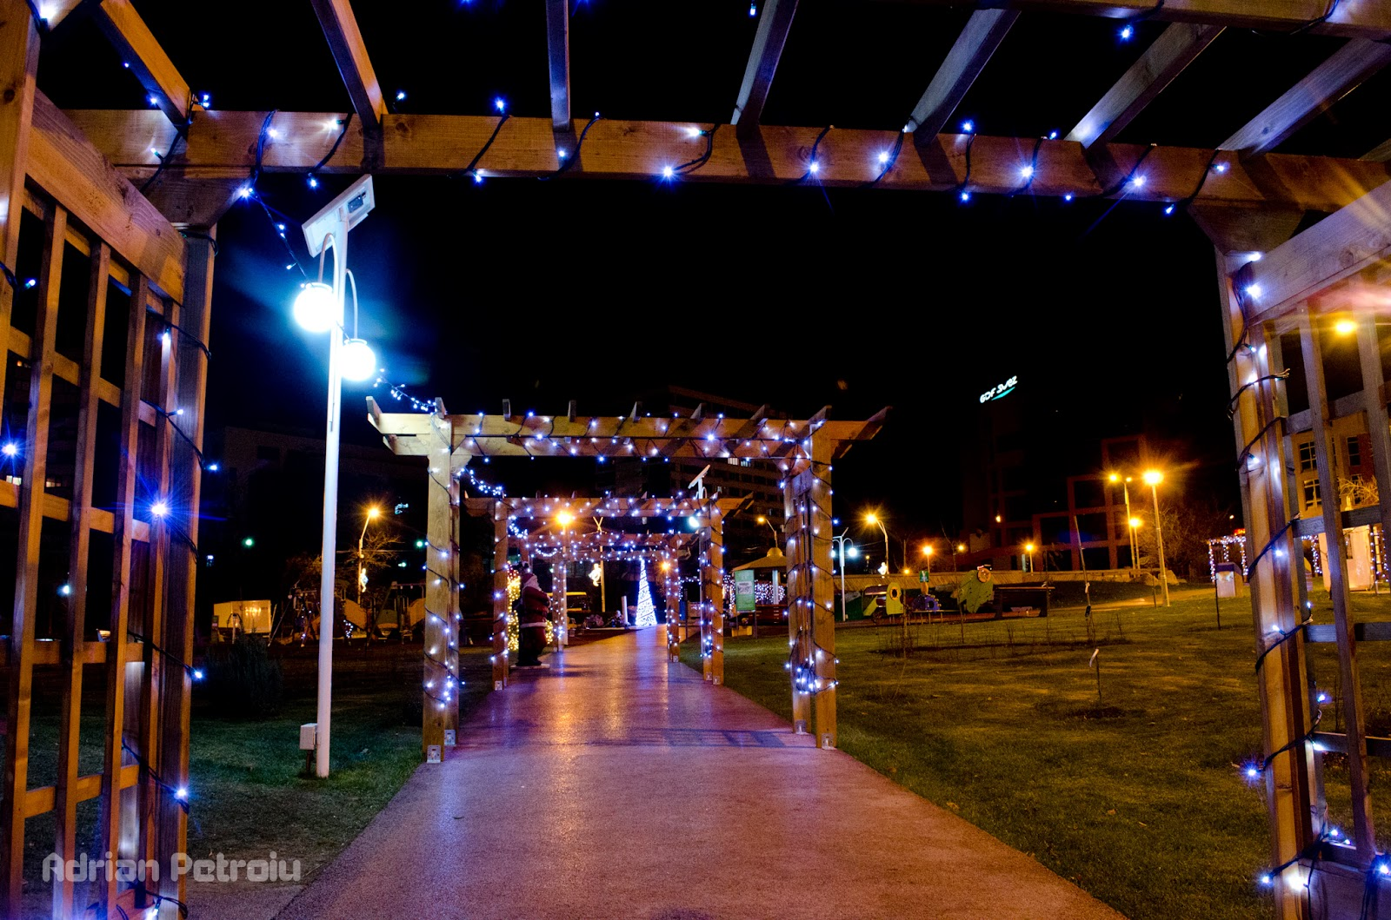
St. Andrew (the city’s patron saint) or Galați’s day. We celebrate it every year on the 30th of November.

Slide 5
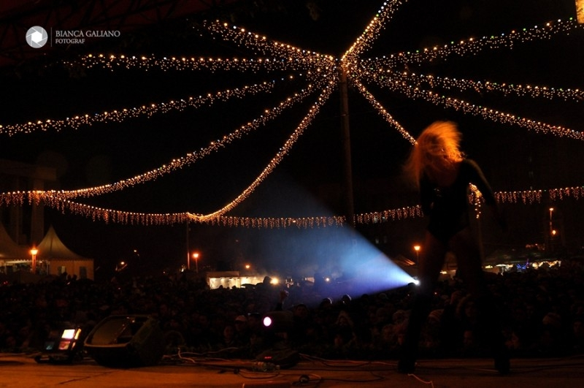
On this day our city hosts many artists and romanian bands to entertain us.

Slide 6
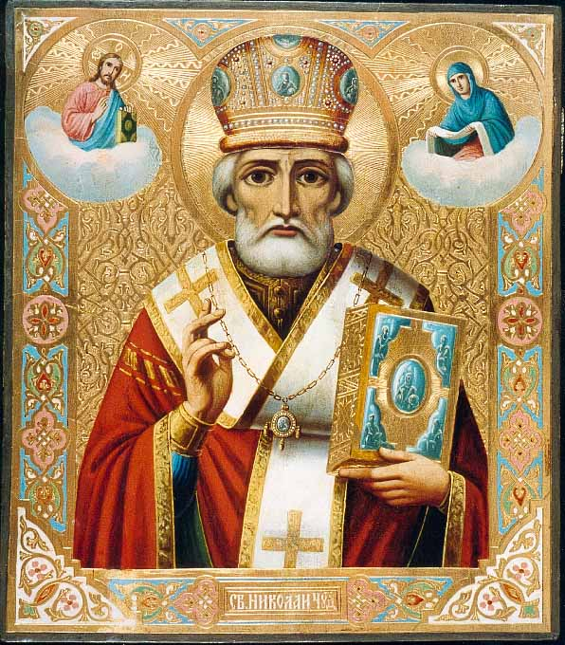
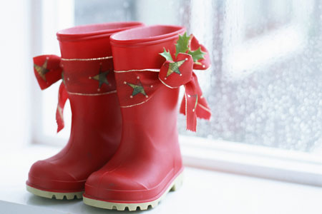
On the 6th of December, we celebrate St. Nicholas, holiday that is known for the gifts the children find in their boots in the morning.

Slide 7
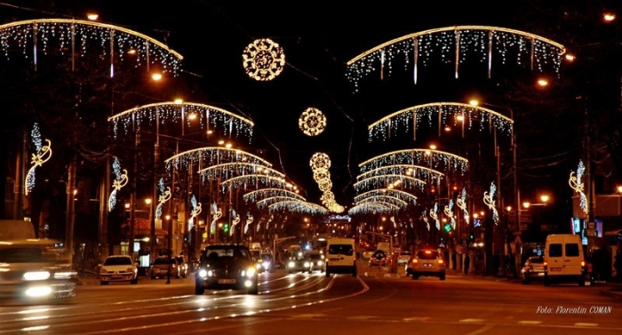
Galați on Christmas days

Slide 8
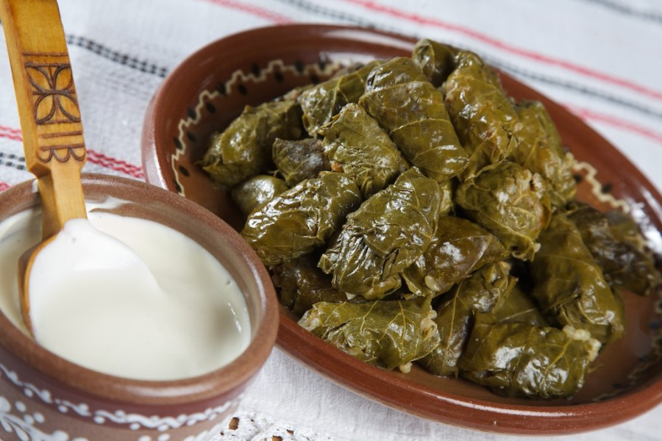
This is a traditional dish we eat around Christmas time, called “sarmale”.

Slide 9
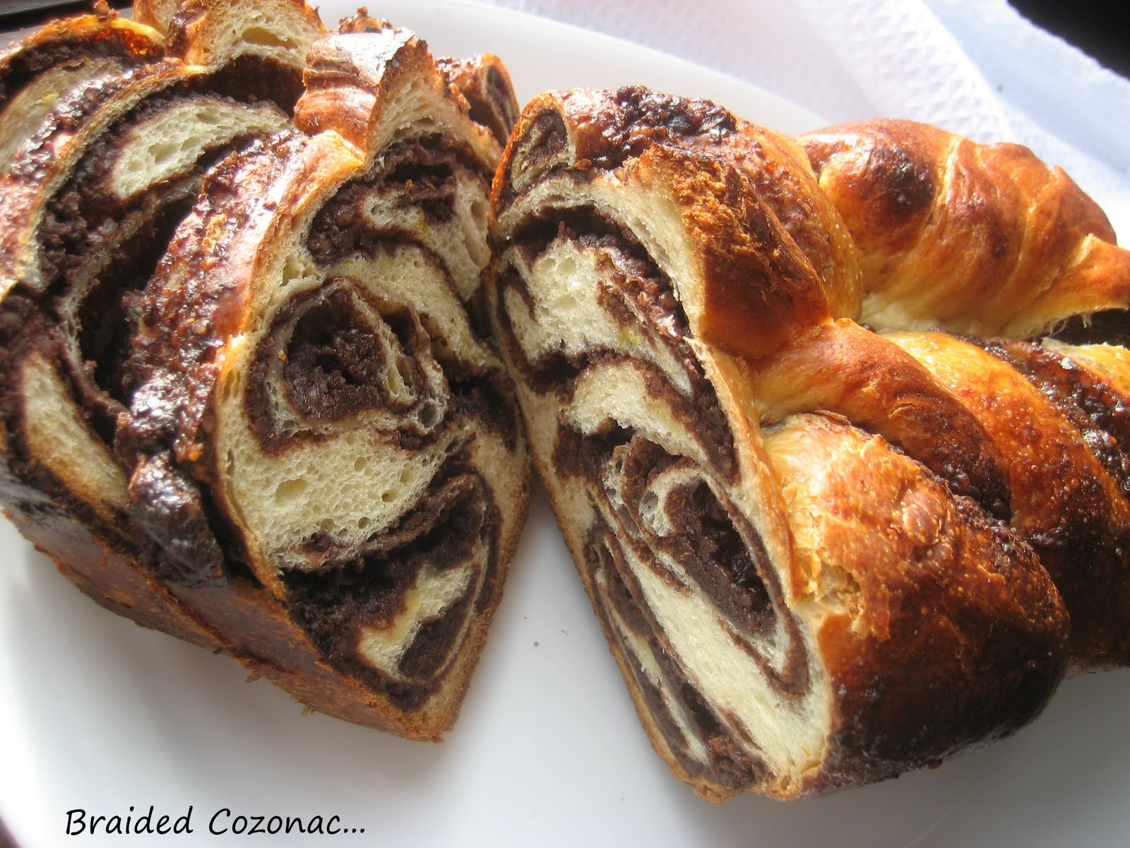
Another traditional dessert dish, called “cozonac” .

Slide 10
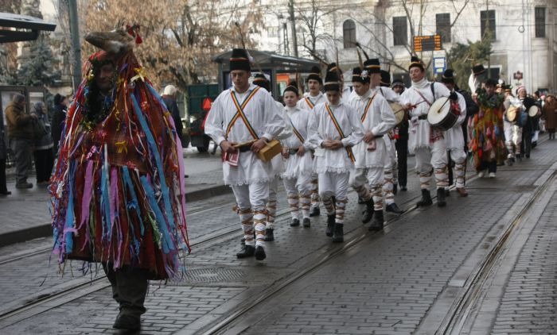
Another important tradition is the carol singing groups and the so-called “goat-parading”. This is an ancient coustom that requires the boys walk on the street dressed up as goats singing, dancing and tapping their feet on the ground.

Slide 11
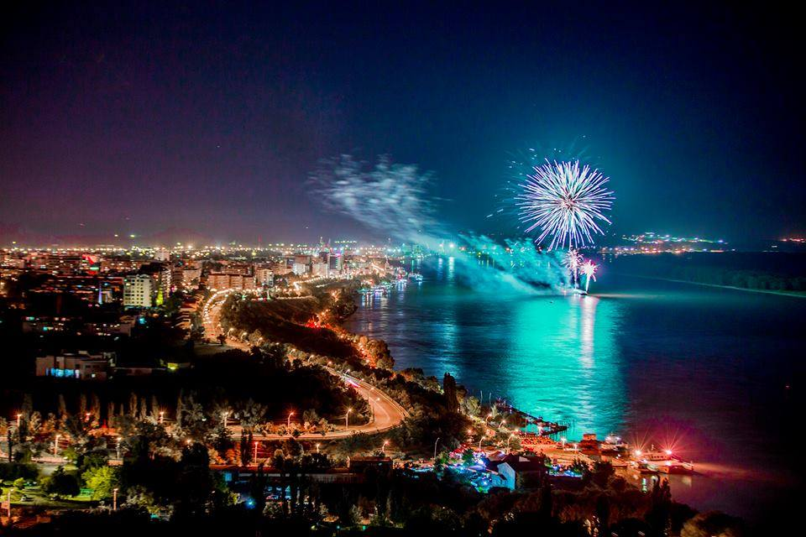
This is our boardwalk by the Danube on The New Year’s Eve !

Slide 12
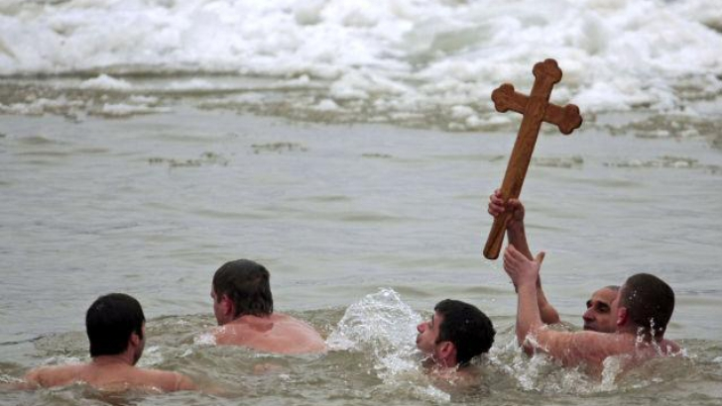
This is a christian tradition that demands a cross being thrown in the Danube by the Bishop and being brought back by swimmers. It takes place on the 6th of January.

Slide 13
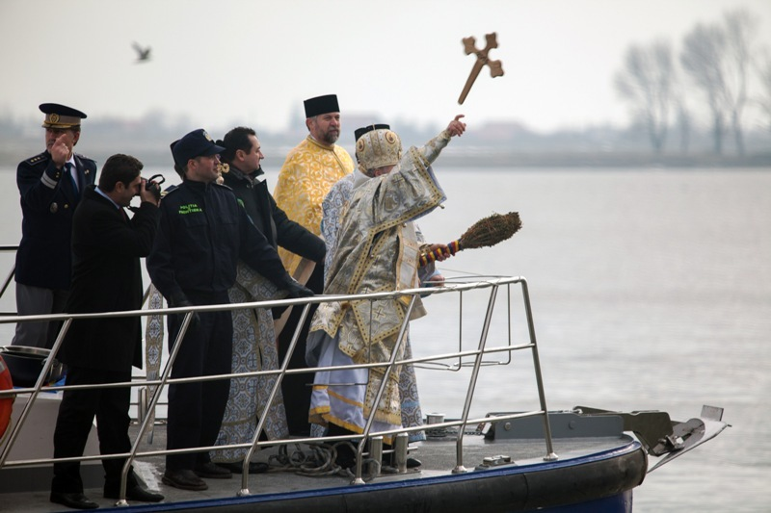
The tradition
This holiday, The Epiphany, represents the baptizing of Jesus by John the Baptist.

Slide 14
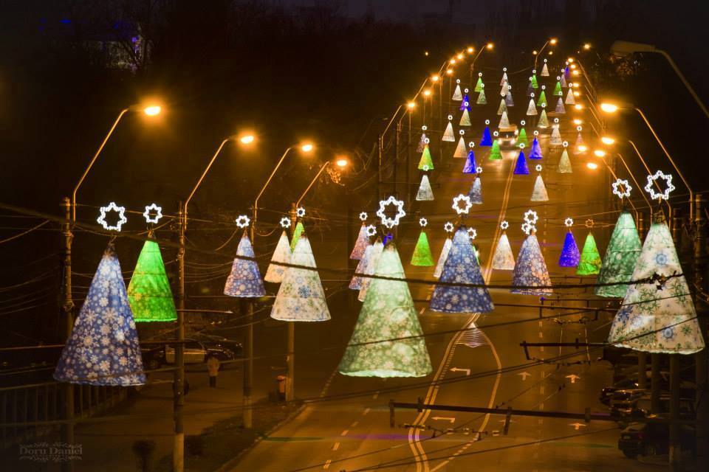
I hope you enjoyed it ! Thanks for watching and see you in winter !

