Slide 2
The Romanian cuisine is extremely varied and includes adopted dishes from the neighbours or from minorities living here.
So, one can find German and Hungarian influences in the “Muntenia” and “Oltenia” areas while the Turkish and Greek influences are to be found in “Ardeal” region. But the most expensive and refined with old genuine elements, we consider, you can find here in “Moldova”.

Slide 3
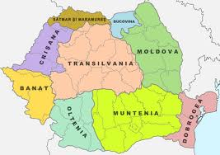

Slide 4
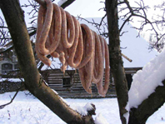
THE WINTER SEASON
Sausages – were made only of pork meat minced with the chopper. Sausages were flavored with garlic and garden thyme. Fresh or smoked sausages, fried in a cauldron were eaten together with pieces of lard, bacon and lean (muscle) and of course with hot polenta while the smoked sausages were preferred simple with garlic and bread

Slide 5
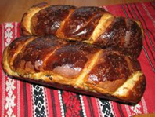
“Cozonacul” – is a festive cake specific to Moldova area. They are baked on the occasion of important religions holidays, but mandatory on Easter. Every housewife has her own recipe for this cake secretly kept

Slide 6
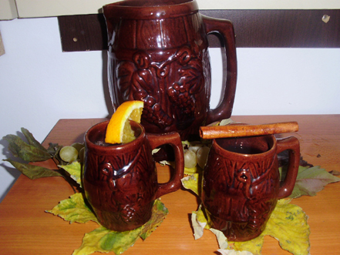
Boiled Wine
Boiled wine is drunk especially during the winter when it is cold outside. We boil mostly red wine and add sugar,
fruits (apples, oranges) and cinnamon to make it more spicy.

Slide 7
The SPRING season
Spring is an important season in any ways for the lent, for the nature rewaking,for the return of birds.
is the season of the greens and of the Easter holiday.

Slide 8
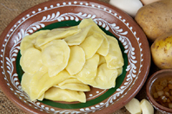
Colțunași
They are given as gifts either to those who are coming into the houses or when you pay a visit.

Slide 9
The SUMMER season
In this season the chicks reach the suitable weight to be cooked.They have meat tender, allowing a fast and very briefl cook: they are fried on coals held on a wooden spike or in a cauldron

Slide 10
The AUTUMN season
Garden fruits and vegetables are consumed now,being the last period of the year they are fresh. All vegetables are ripe and easy to find,fruits as well.

Slide 11
People start making wine-in its first stage called “tulburel” (thick wine) because it is boiling.

