Slide 1
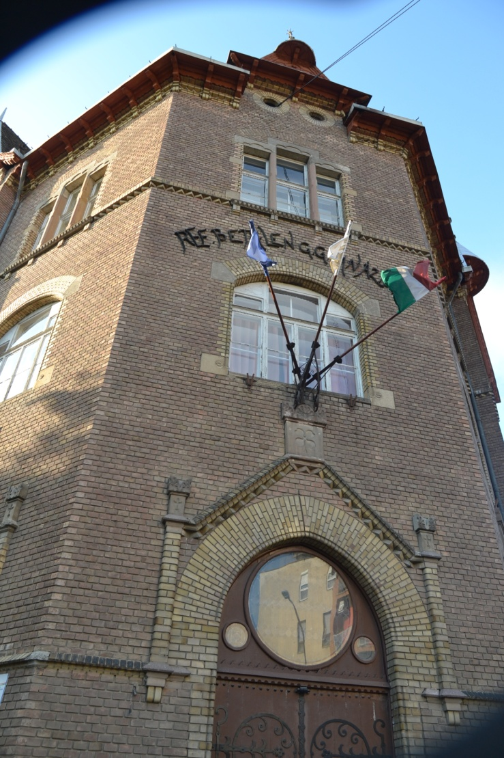
Our School
Bethlen Gábor Reformed High School

Slide 2
Gábor Bethlen (1580-1629)
denominator of the school
was born in Romania
king of Hungary and Transylvania
Habsburg absolutism in Royal Hungary
has consolidated Transylvania’s position – known as „The golden age of the Transylvanian principality (1606–1660)

Slide 3
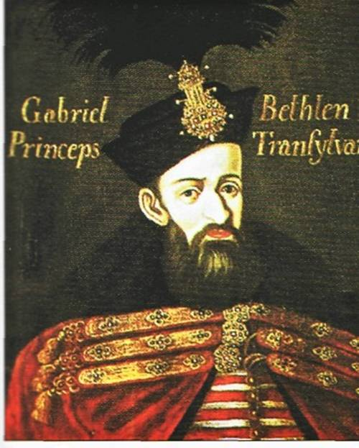

Slide 4
History of the school:
built in 1896 by Sándy Gyula
founded by the Presbyterian association
built in Gothic style
denominated of Gábor Bethlen

Slide 5
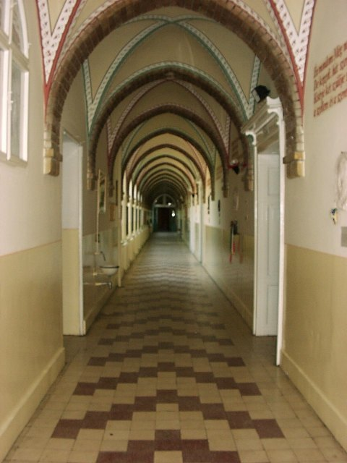
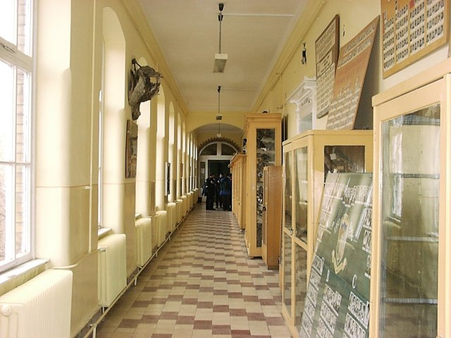
Inside:

Slide 6
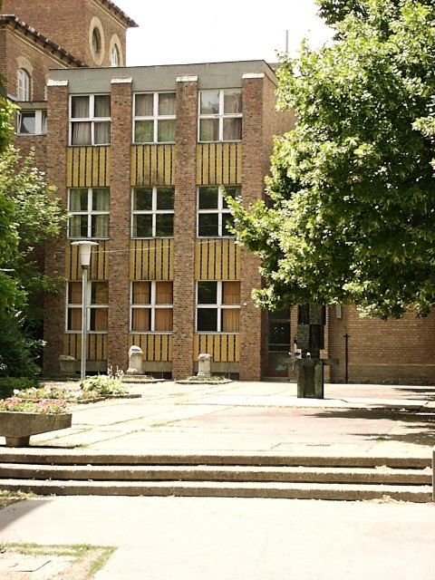
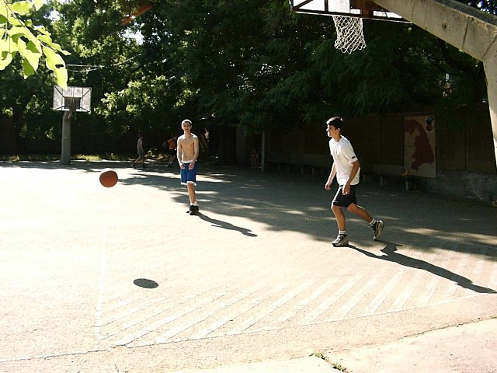
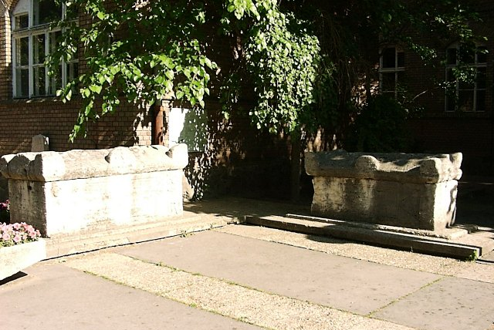
Outside:

Slide 7
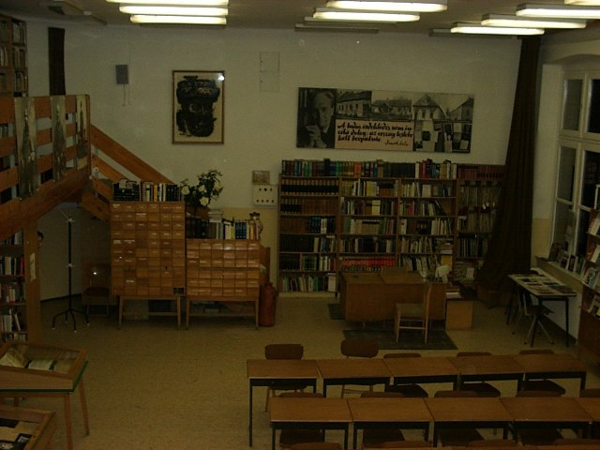
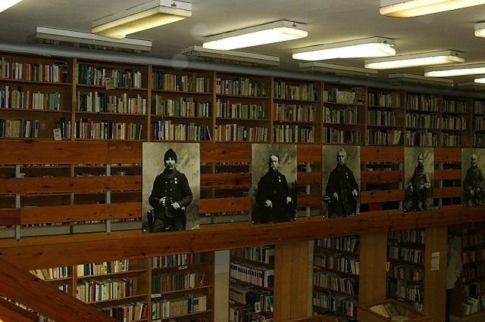
Library:
very old library
6000 books
a century and a
half years old

Slide 8
Classes (faculties):
Biology and chemistry
Maths and physics
History and literature
English
„General”

Slide 9
Biology and chemistry:
high level
Latin language
special labs

Slide 10
Maths and physics:
high level
for example
nuclear physics

Slide 11
History and literature:
high level
in the future:
lawyers, notaries,
actors, teachers

Slide 12
English:
high level
exchange student programs (Italian, Dutch, French)
teachers or
interpreters

Slide 13
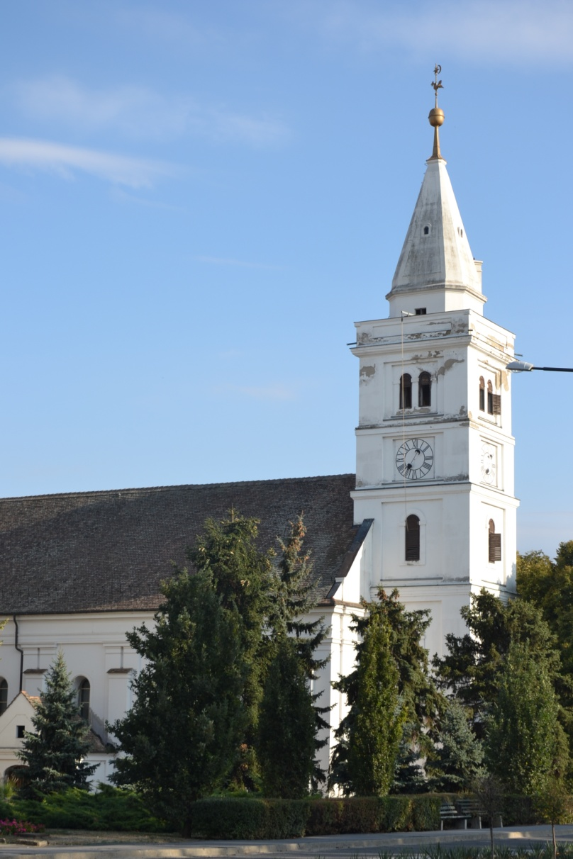
Religion:
big emphasis
open for every religion
devotion twice a week
church next to
the school

Slide 14
Languages:
at least two foreign languages
choose from: English, German, Italian,
French, Russian, Latin

Slide 15
4-year training:
entrance exam of maths and grammar
after the 8th grade of primary school
choose from the high level classes
(faculties)
8-year training:
after the 4th grade of primary school
both can choose two main subjects in the
11th grade

Slide 16
Main programs in the year:
Bethlen-ball
Bethlen-night
Christmas shows
Student day
Walk trips to Mártély

Slide 17
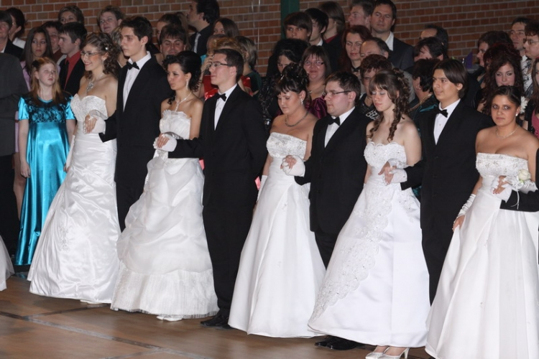
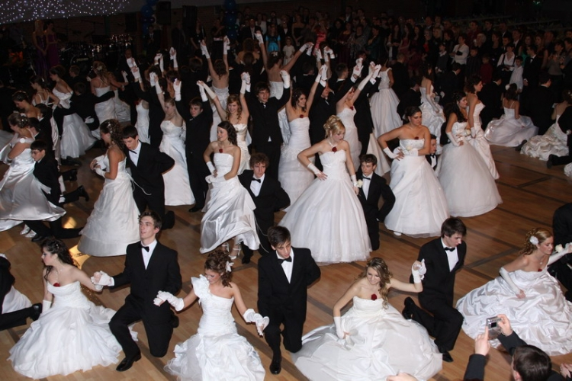
Bethlen-ball
Most important night
The school-leaver class’s dance
Dinner

Slide 18
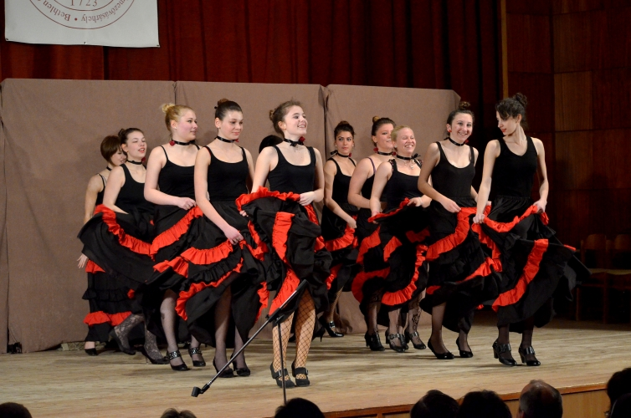
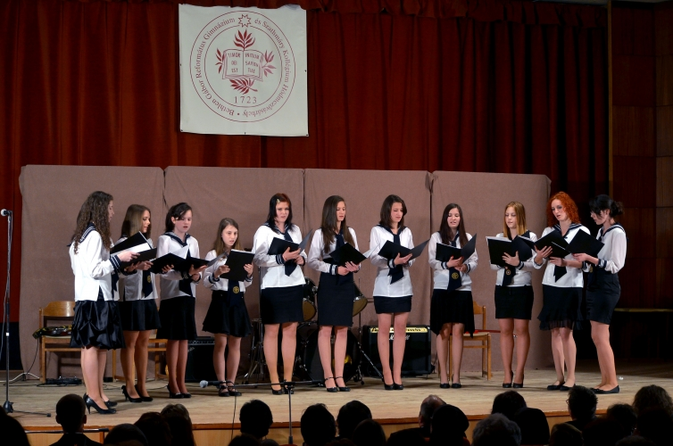
Bethlen-night:
talent show
dancers, singers
funny and intimate atmosphere

Slide 19
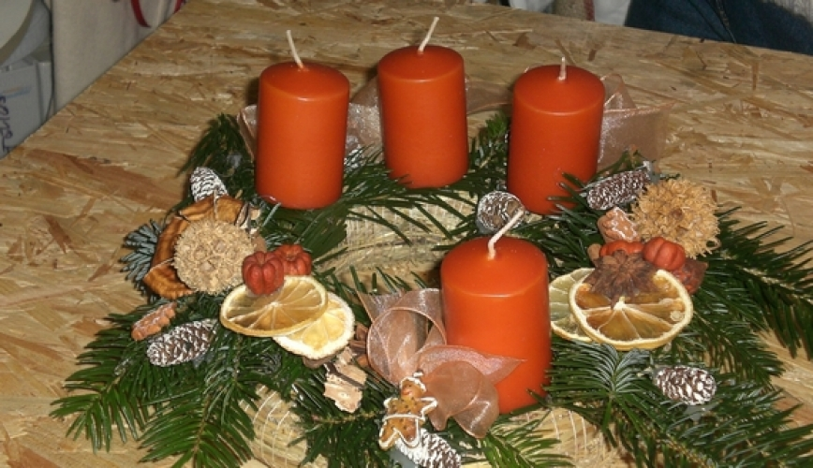
Christmas shows:
shows for every teacher from students
Christmas presents
theater scenes, poems, songs

Slide 20
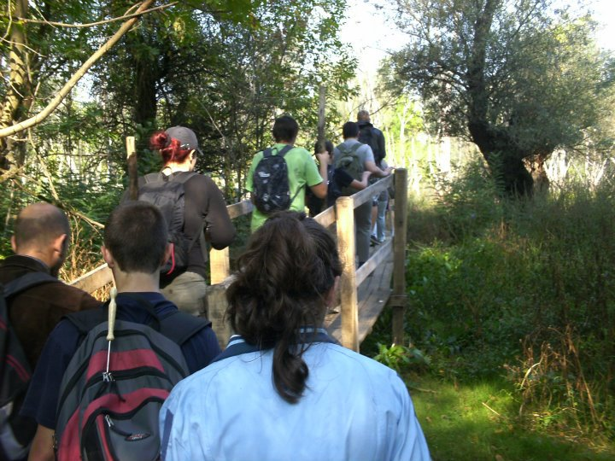
Walk trips to Mártély:
every class participates
solve exercises

Slide 21
College and meal:
own college: Szathmáry College
free college
study room
meals in the
Cseresnyés
College

