Slide 1
Local handicrafts in Campania
Life is what happens to you
while you're busy making projects.

Slide 2
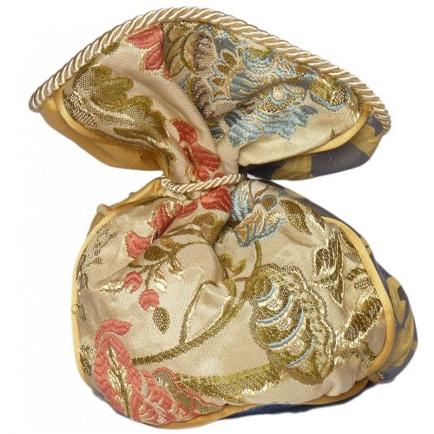
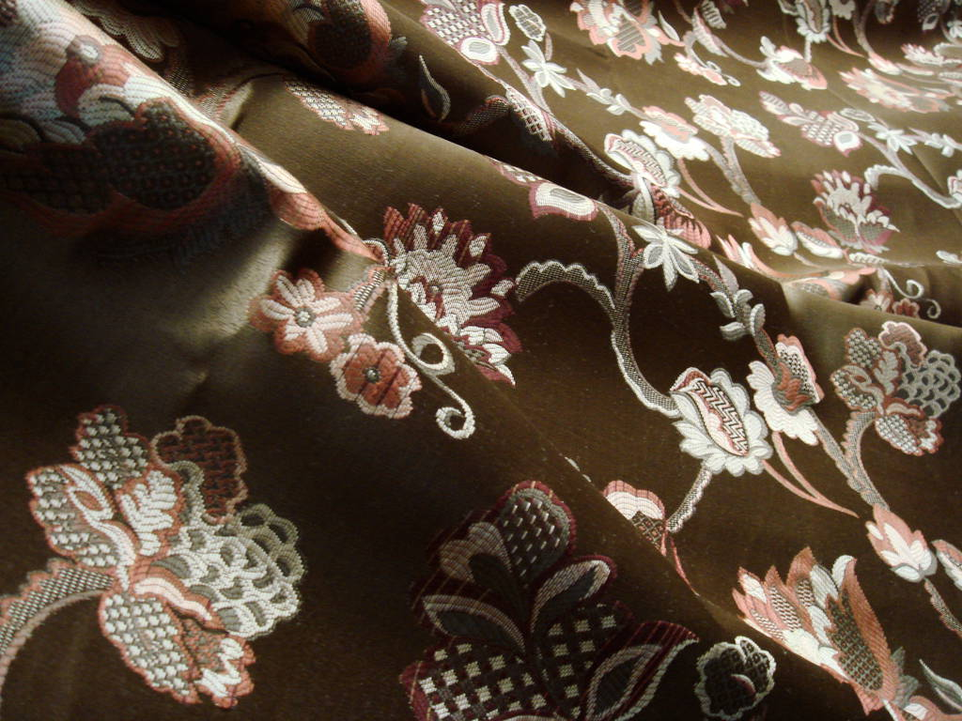
The Old Silks of San Leucio

Slide 3
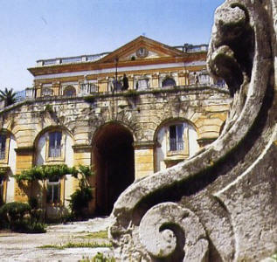
San Leucio is a small village located 3.5 km north west of Caserta, in Campania. It is known for both historical and artistic reasons.
The royal site, along with the Royal Palace of Caserta, has been awarded as a World Heritage Site by UNESCO.

Slide 4
It was1789, the thirtieth year of the reign of Ferdinand IV (III of Sicily). The life and the din of the ‘Reggia’ (the royal palace in Caserta) distressed him so he decided to go and live in a quiet place, a hill nearby, with a wonderful view. In this place, there was the ancient church of San Leucio, after the name of the Bishop of Brindisi.
The king had a hunting lodge built on the Belvedere, and some families settled there to provide for his needs. The settlers increased in number and became a small community which became a utopian model of life. Ferdinand wanted this colony have economic independence, creating a silk factory and a textile factory.
It was regulated by a code, written in his hand, full of extraordinary rules and ideas of equality, social security, human rights, solidarity.
The new name of the place was Ferdinandopoli, after his name, in short, even though the name remained artificial and no one ever used it: since then it has always been called “San Leucio”.

Slide 5
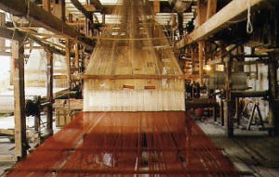

Slide 6
Everything revolved around the factory that flourished and produced a rich variety of fabrics, though it was never able to reach economic growth because the profit was not its main goal: it was meant to the welfare of the community.
There was an important silk factory, supported by the King "with powerful means," which used the raw material generated by silkworms reared in homes of Caserta and surrounding places. From the first spinning machines and looms until the construction of a large textile mill. They produced fabrics for clothing and wallpaper, in a wide range of satins, brocades, velvets. In the early decades of the nineteenth century, with the introduction of the Jacquard weaving, production was enriched with brocade fabrics of silk, gold and silver, shawls, scarves, lace. It also developed local products, the ‘gros de Naples’ and a fabric for clothing called ‘Leuceide’.
The orders of silk came from all over Europe: even today, the productions of San Leucio can be found in the Vatican, at the Quirinale, in the Oval Office of the White House: the flags of the latter and those of Buckingham Palace are made with such material.

Slide 7
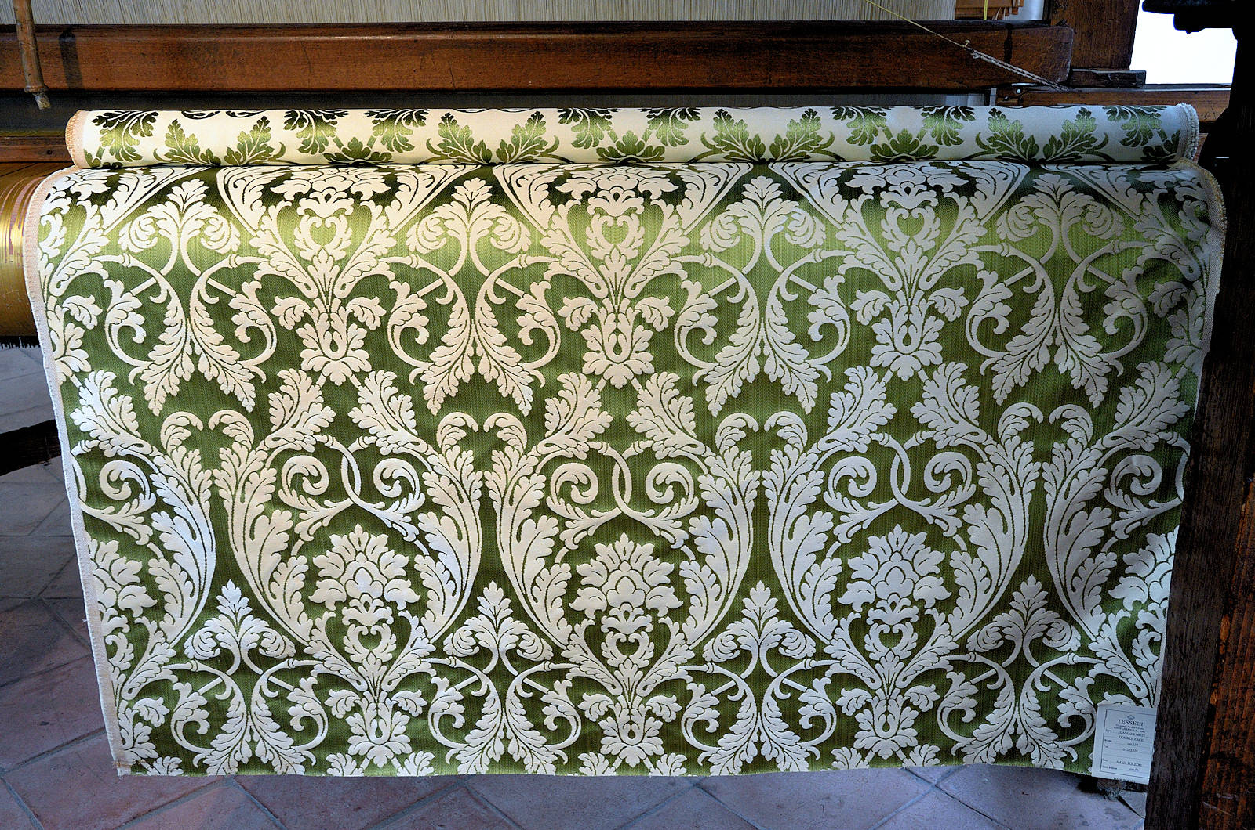

Slide 8
The fabrics of San Leucio had supplied the rulers of the house of Bourbon and Neapolitan nobility and bourgeoisie, both for clothing and for the upholstery. The manufacture survived the Kingdom of the Two Sicilies and the domination of Savoy and, although with very different characteristics, today it goes on to keep alive a valuable tradition , that is, in fact, spread throughout the world.
San Leucio stood perfectly for many years, then it was gradually destroyed by the Napoleonic invasions and strong population growth.
The utopia of San Leucio ended when in 1861, following the invasion of Savoy, the kingdom became part of Piedmont: the silk factory was given to private businessmen, and the king’s charter became waste paper.
Both the architectural beauties designed by Ferdinand Collecini, a student of Vanvitelli, and the natural beauty continue to radiate their suggestions.
It is worth to pay a visit to the ancient village: who knows that the spirit of the old king, who continues to wander the streets where he had started the separation of pedestrian traffic from vehicles, perhaps even angry for having been won by an old bishop, Leucio, whose name was never replaced by ‘Ferdinandopoli’!

Slide 9
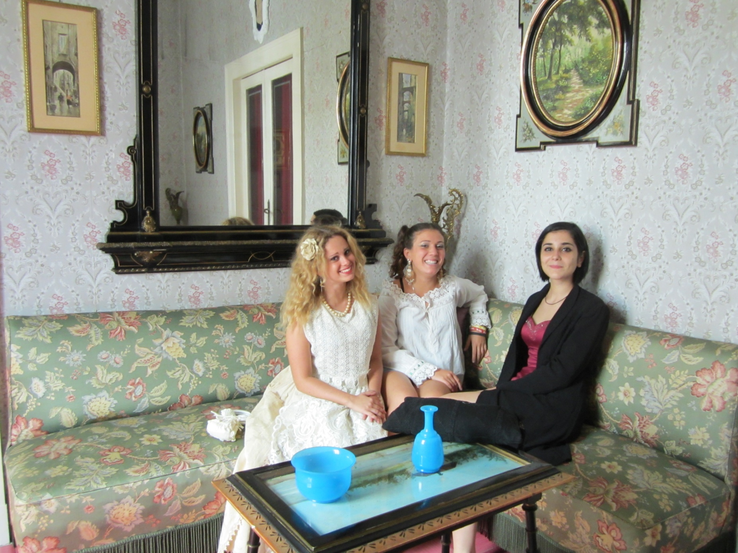

Slide 10
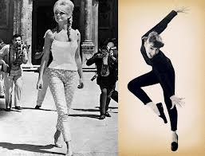
Capri Pants

Slide 11
The Capri Pant, originally named after the Isle of Capri, became one of Audrey Hepburn’s symbols in the 1950s in the movie ‘Sabrina’; Brigitte Bardot was photographed most often in Capri pants; more and more celebrities started to pick up on the style, but more importantly they were the calibre of celebrity that had the clout to turn Capri pants into a fashion classic: Sophia Loren, Elizabeth Taylor, Marilyn Monroe, Gina Lollobrigida, all stars whose images have survived the test of time.
In the famous ‘piazzetta’ in Capri there is a point of reference for chic ladies: ‘La Parisienne,’ a shop where high fashion meets high craftsmanship and tailoring of excellence. It is here that the pants called "Capri" were born,
Since 1906, in this boutique celebrities from all over the world have done their shopping: Charlie Chaplin, who often bought Capri pants, Clark Gable, Gabriella of Savoy, Liz Taylor, Maria Callas and Jacqueline Onassis, who even used to buy12 pants at a time to keep them in the houses she owned in several seaside resorts.
Among the most recent clients John Bon Jovi chose a pair of patchwork pants.
White Capris are a modern classic for every wardrobe. Available in a range of materials, they're the perfect no-nonsense pants for many occasions and can dress up or dress down with ease.

Slide 12
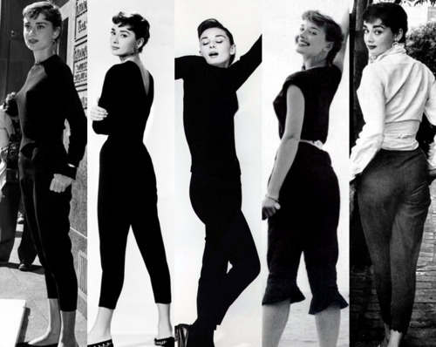

Slide 13
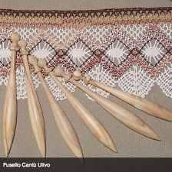
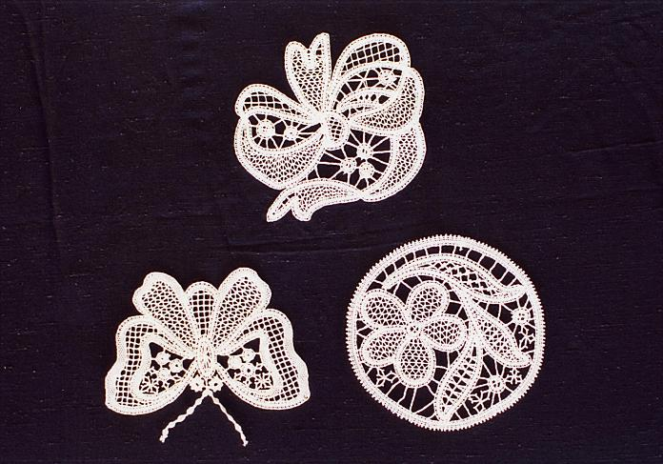
Lace making

Slide 14
Today, the art of lace making has become increasingly appreciated by those who admire and love beauty. The uniqueness of handmade lace, lace making difficult technique, proved in the long time of production it needs, like our ancestors, make the products of this art greatly appreciated. The skill of such an embroidery becomes a real treasure to pass on from generation to generation, it is almost a form of investment due to the rarity of works and drawings which are jealously preserved by those who still handcraft embroidery.
Indeed, the image that represents an elderly woman near the fireplace devoted to embroidery and surrounded by other women and children of the family, is still current in small villages in Campania . Of course, there are the seasons, changing habits, but the tradition remains unchanged and the story goes on.

Slide 15
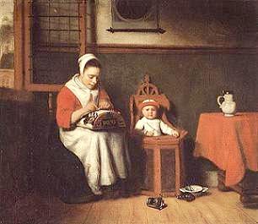
Nicolas Maes
“La merlettaia” 1650
Metropolitan Museum of Art NY

Slide 16
In Campania region lace arose and spread as a decoration for clothes and church vestments. In the courts of the nobles lots of skilled lace-makers were working night and day to make masterpieces and create new designs, sometimes even noblewomen enjoyed this art.
In many countries of Irpinia and Salerno this form of craft has developed and the small towns and villages where today beautiful laces are produced are: Santa Paolina, Tufo, Montefusco, Battipaglia, Positano; in these places, in fact, the tradition is handed down from mother to daughter.
It is believed that the origins of this art are to be found in Abruzzo. In Campania, however, it had already spread at the time of Joan of Aragon (Naples, 1502-1575). It is since ancient times, therefore, that these stylish laces embellish traditional bottom drawers of young brides and houses.

Slide 17
Carving of Cameos and Corals
The origin of the coral has been shrouded in legend for centuries, Ovid's "Metamorphoses" and Pliny the Elder in his "Naturalis Historia" ascribed the same mythical genesis to the coral: the blood dripping from the cut head of the Medusa Gorgon, turned into coral.
Its warm and lively colour, the marine origin, its ambiguous nature had greatly impressed the first peoples of the Mediterranean, they began to work it and got it to be known throughout the world.

Slide 18
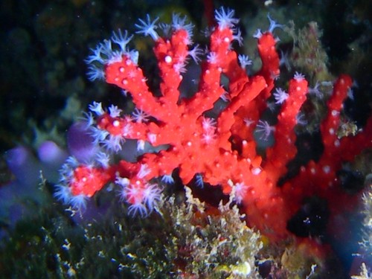

Slide 19
The coral was discovered only at the beginning of the '700 by doctor Peissonnel from Marseille: it was not a mineral but a calcareous secretion produced by colonies of microorganisms of animal origin and therefore, the red coral of the Mediterranean seduced all peoples who came to know it.
From the Mongols to the Indians, from Chinese to American Indians, but also in Yemen, Turkey, Uzbekistan, Nigeria, North Africa and Europe, over the centuries, have universally believed in the power of luck of the coral.
In fact, the coral has always been fascinating because of its contradictory nature: non-mineral, even though petrified, not a vegetable but tree-shaped, not an animal though blood coloured.
The Coral was thought to have apotropaic, propitiatory and therapeutic power; it fostered welfare, fertility, longevity and it was considered a defensive element, In short, in many cultures it represents a "defense" and especially protects those who wear it, especially in the most vulnerable periods of ones life: birth, puberty, marriage.
The coral has passed centuries and civilizations mingling with local traditions; today it still represents a source of beauty because, to quote the merchant Piczenik Nissen, "corals take them all, rich and poor, elevate and adorn simple people and decorate aristocratic people. You can wear it in the morning, at noon, in the evening and at night, (...) when working and when relaxing, in both happy and sad times. "

Slide 20
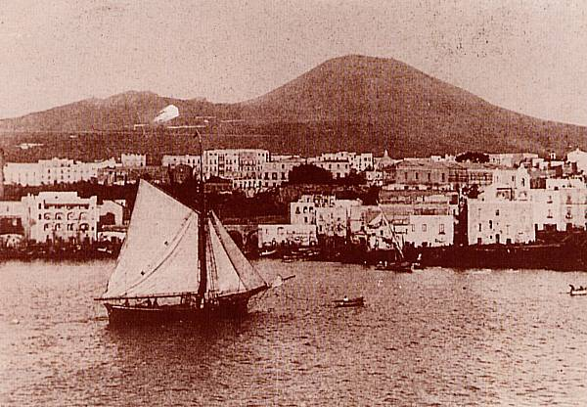
Corals and Cameos from Torre del Greco

Slide 21
The coral fishing in Torre del Greco, a town near Naples, has been carried out from immemorial time and the incomings of the coral fishers were so considerable that Ferdinand IV of Bourbon called the city “golden sponge" of his reign.
In the '500 Torre del Greco people went out fishing also in the sea of Corsica and Sardinia and in 1688 they had over 500 fishing boats, in 1780 they ventured to the coasts of Africa, winning the competition with Trapani, Genoa, Livorno and Marseille.
Torre del Greco boasts the main coral and cameos factories in Italy.
There are several laboratories in which special techniques of working the coral are used, while the cameo engraving is carried out by expert craftsmen. The technique of engraving has passed from father to son. Besides coral, shells (Cameo), the Vesuvian lava, mother of pearl and ivory are engraved by these rare experts.

Slide 22
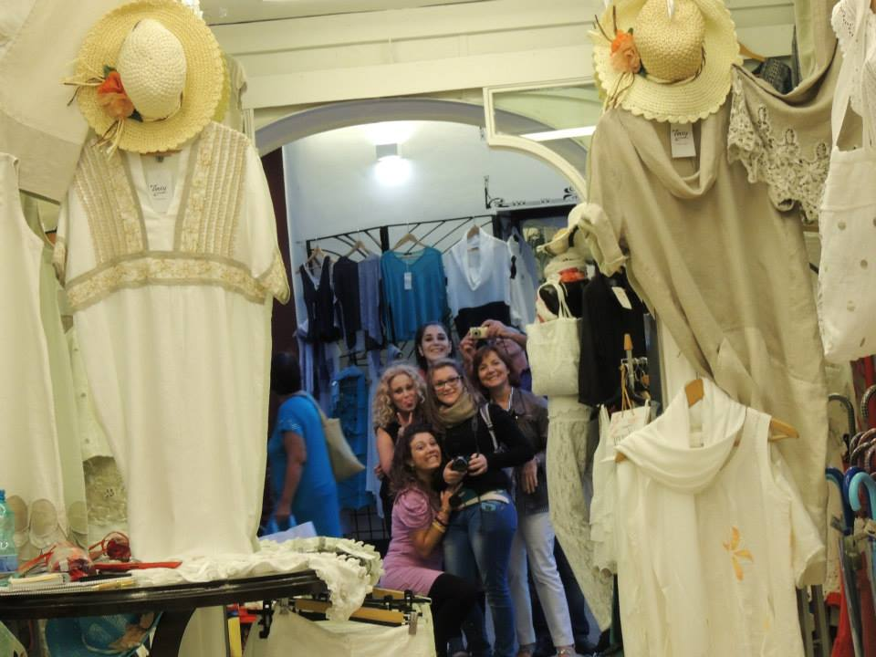
Positano Fashion

Slide 23
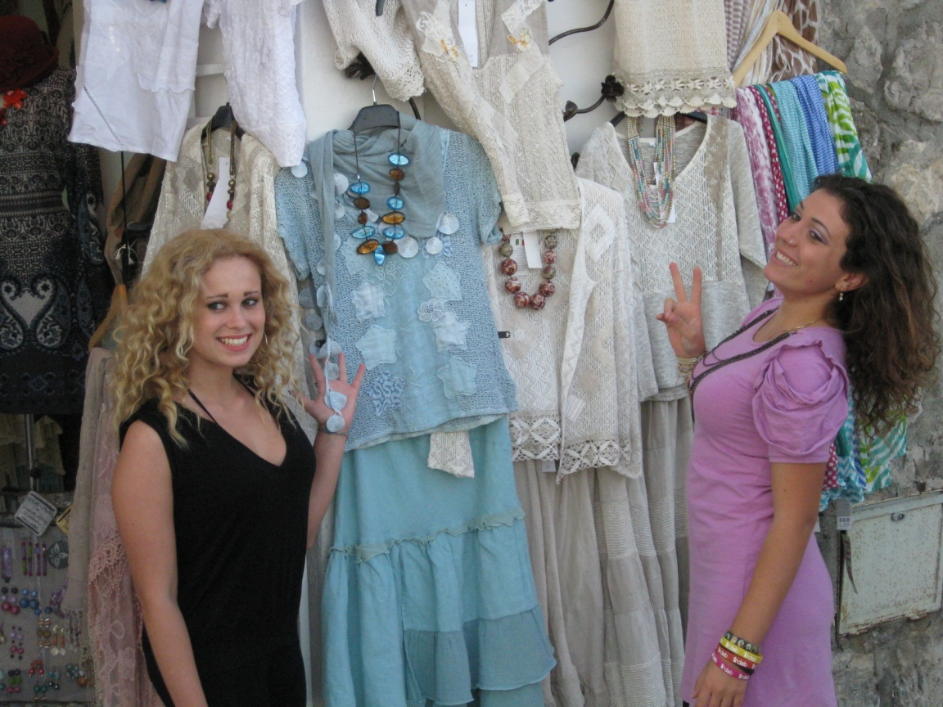
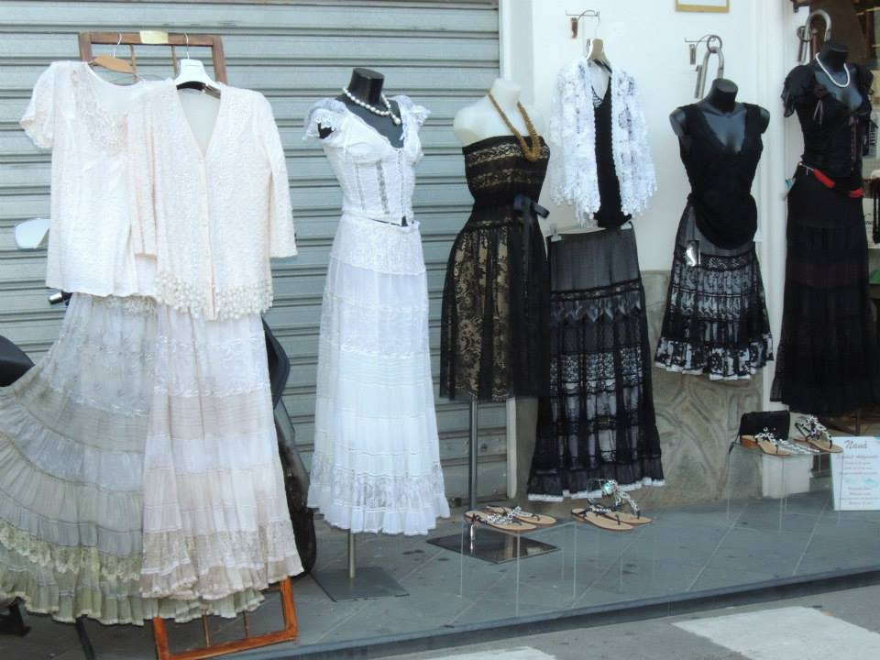

Slide 24
In the famous 60s, besides the hippie phenomenon, Positano discovered and experienced a new fashion.
Since the original inhabitants were traders and businessmen, they invented the famous Positano Fashion. They turned successful tailors cutting scarves, towels, linen or cotton; transforming fine linen hand embroidered, old tableclothes, pillow laced or crocheted, in elegant evening dresse, gowns and shirts.
This extravagant fashion was appreciated from the very first moments because it was very different and essential to the citizens.
Tailor merchants invented the dyed fabrics; they imported Indian raised fabrics and mixed them with old laces taken from their women’s bottom drawers.
Among them Rachele Talamo, an experienced and imaginative local seamstress, had a great time by buying fabrics at her own expense and making appliqué clothes, which were sold like hot cakes. The phenomenon of ‘patches’, bizarre, elegant and artistic clothes, attracted considerable interest throughout Italy and soon after in many countries of the world. In the eighties, inhabitants from Positano got the highest incomings in Italy, until the early 90s.

Slide 25
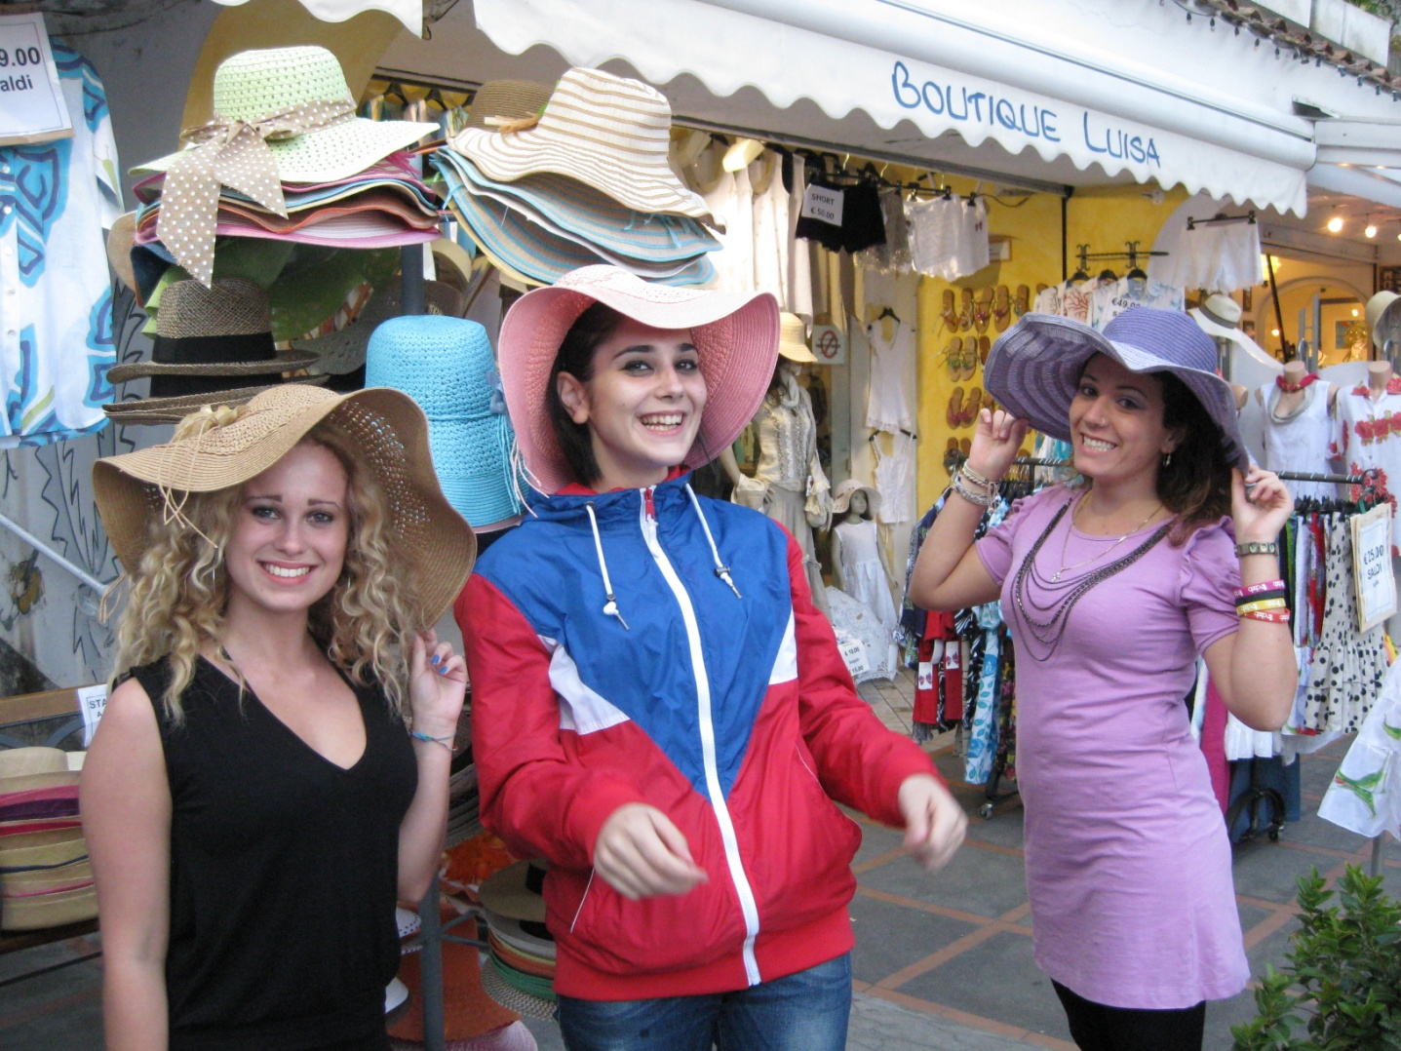

Slide 26
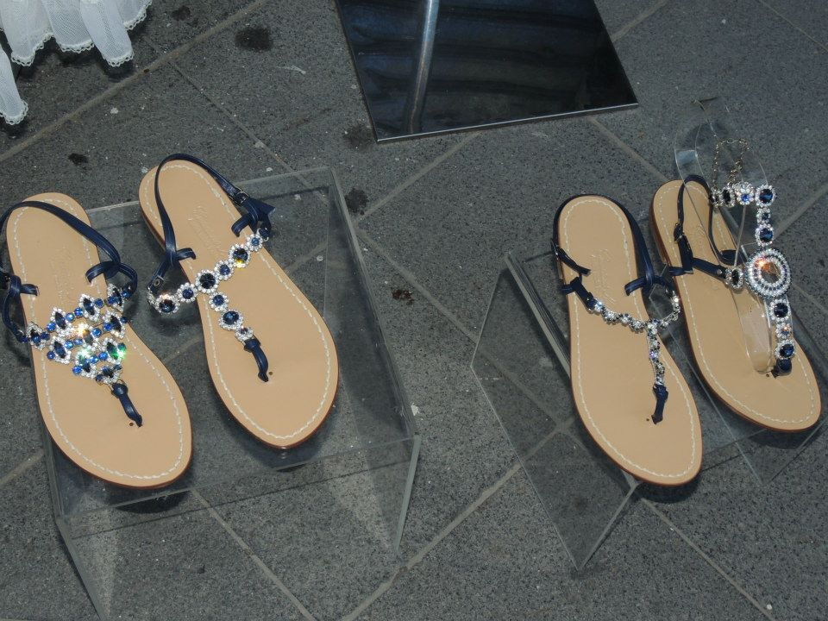
The Sandals of Positano

Slide 27
The sandals of Positano, one of the most picturesque areas of the Amalfi Coast, are appreciated in Italy and abroad for high quality and originality. A successful result of tradition, creativity and high-handedness of the master shoemakers of the place.
The Tradition
Today the sandal is a real fashion symbol, in its simplest form it was the first footwear item in the history of man: evidences date back to the ancient Egyptians then to the Greeks and the Romans,. The tradition of making the tailor-made sandals was born in Positano after the Second World War. The shoemakers from Positano were priviliged by their imagination, creativity, good taste and a strong professional skill. Their sandals, which at first were simple but comfortable, gained in a short time lots of appreciations from both famous and ordinary people who contributed to create the myth of the sandals in Positano, a symbol of the Amalfi Coast.

Slide 28
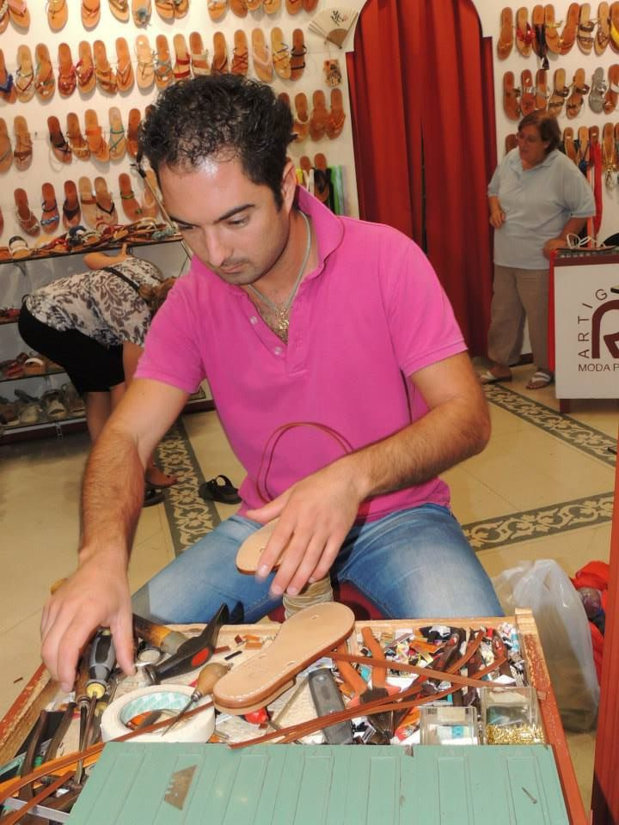
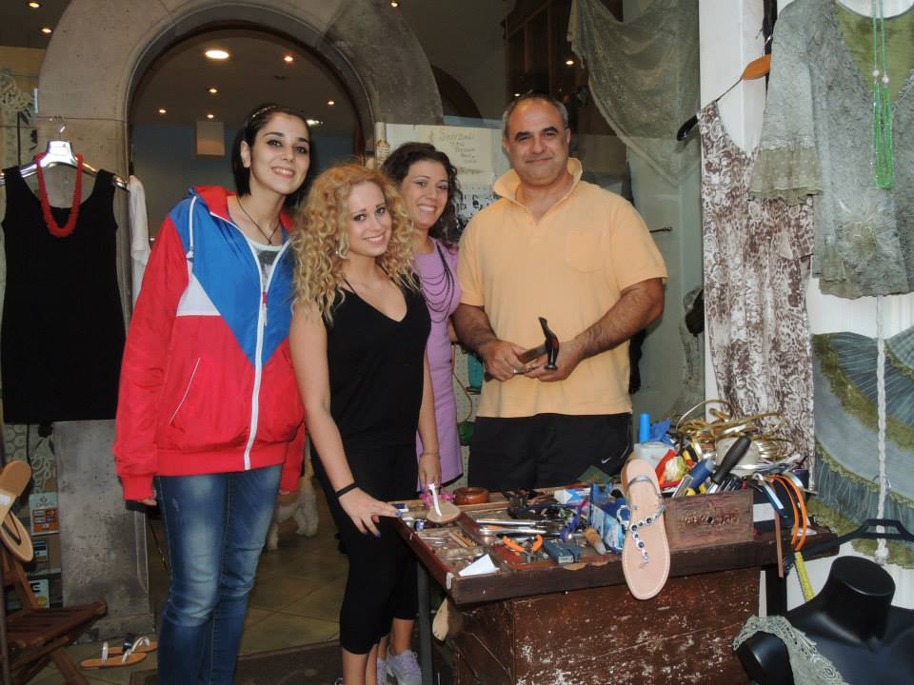

Slide 29
Features
The sandals are the result of a careful work of master shoemakers, an activity whose secrets of perfection and art were handed down from generation to generation.
Shoemaker’s knives, files, awls and pliers are the few support tools to the shoemakers in the creation of unique models, a working skill starting from the selection of good quality leather and materials. The peculiarity of these sandals is in the preparation, characterized by two layers of leather sewn with the use of a string and no use of glue to attach sole and upper.
At first the most popular models were the ones in the Franciscan style or the ‘spider web’ style; after, to meet the demand of the fashion but without neglecting the traditional features, shoemakers embellished them with the application of semi-precious stones and jewelry with turquoise, coral, rhinestones, beads and Swarovski crystals.

Slide 30
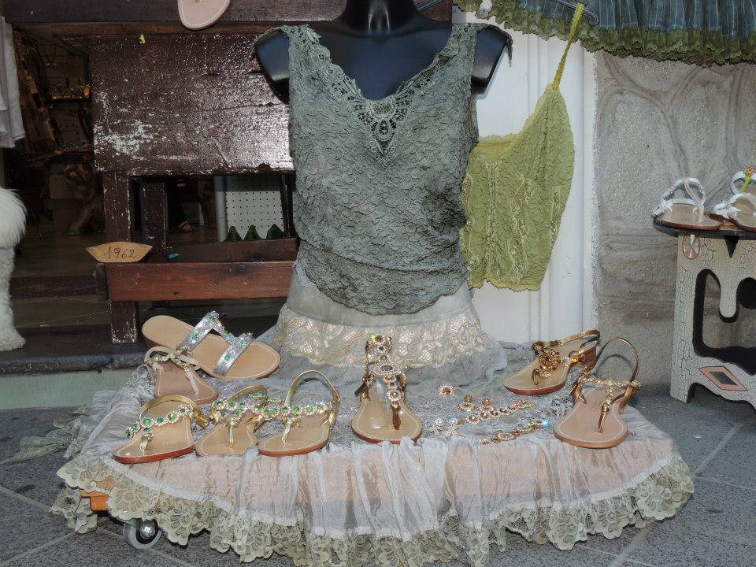

Slide 31
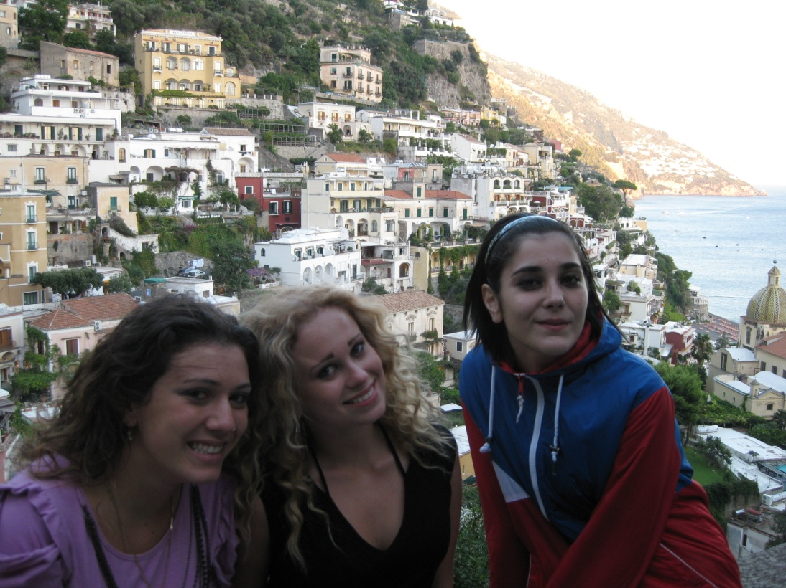
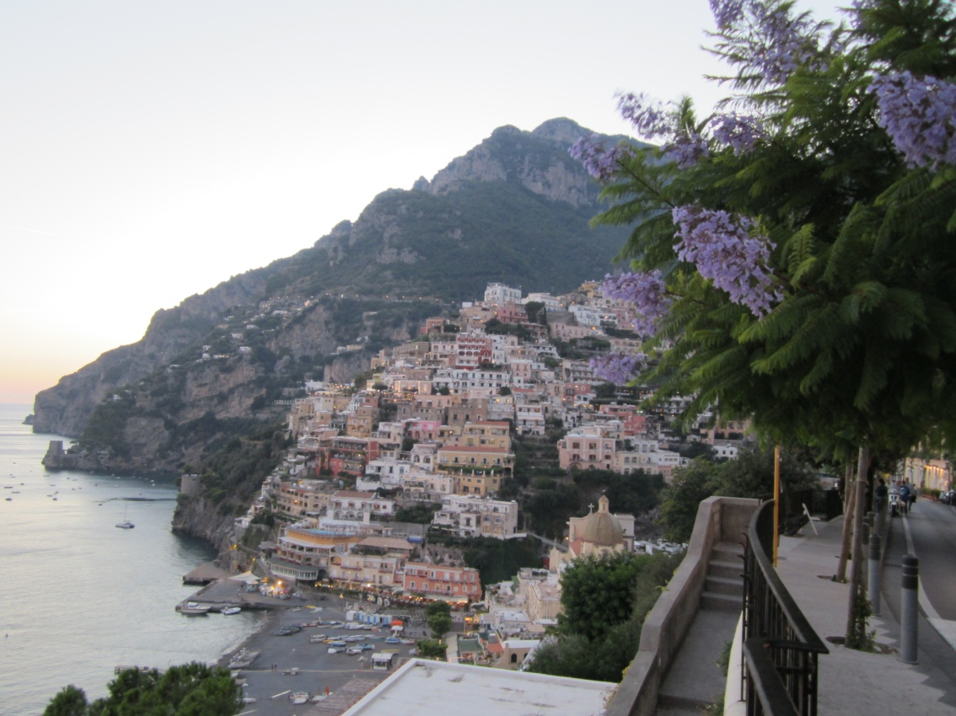

Slide 32
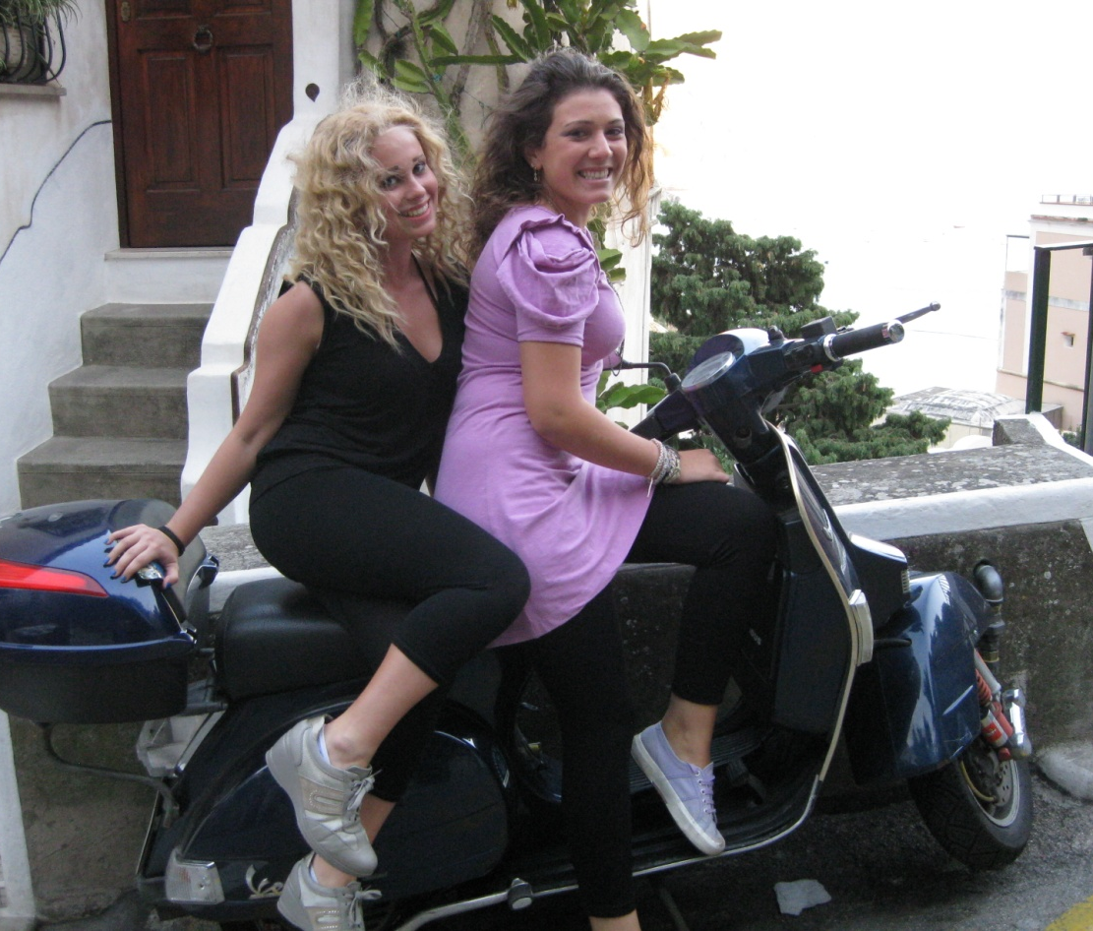
Goodbye from Italy

