Slide 1
A tailor made stunning tour for “Comenius project”
Exploring our area to focus on its characteristics..
Itinerary folder
Walking through narrow
paths between the houses

Slide 2
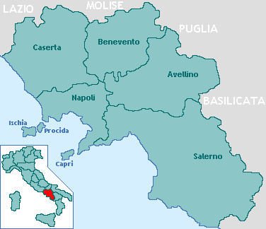
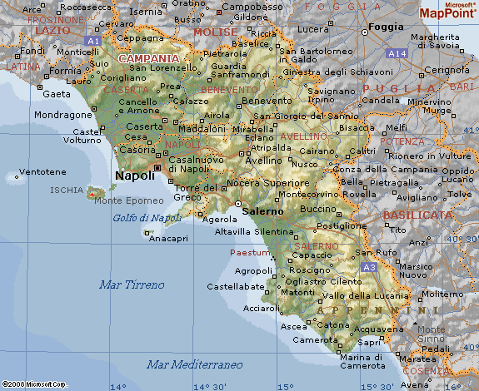
Looking at the map
Destination: Campania
Located on the Italian Peninsula, Campania was colonized by Ancient Greeks and was part of Magna Græcia.
During the Roman era the area maintained a Greco-Roman culture. The capital city of Campania is Naples.

Slide 3
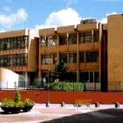
If you have never visited Nocera Inferiore, start from the heart of its historical centre..
Our tour begins in “Piazza Maestri del lavoro d’Italia” where our school is situated.
Nocera Inferiore is one of the most highly populated cities in the entire province and the industrial hub in the area for the past century.
Around the X century “Civitas Nuceriae”
was built, the city was reborn
centuries after the fall of the Roman settlement.

Slide 4
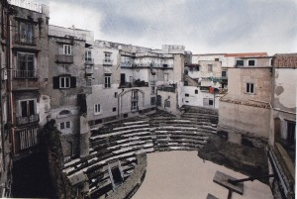
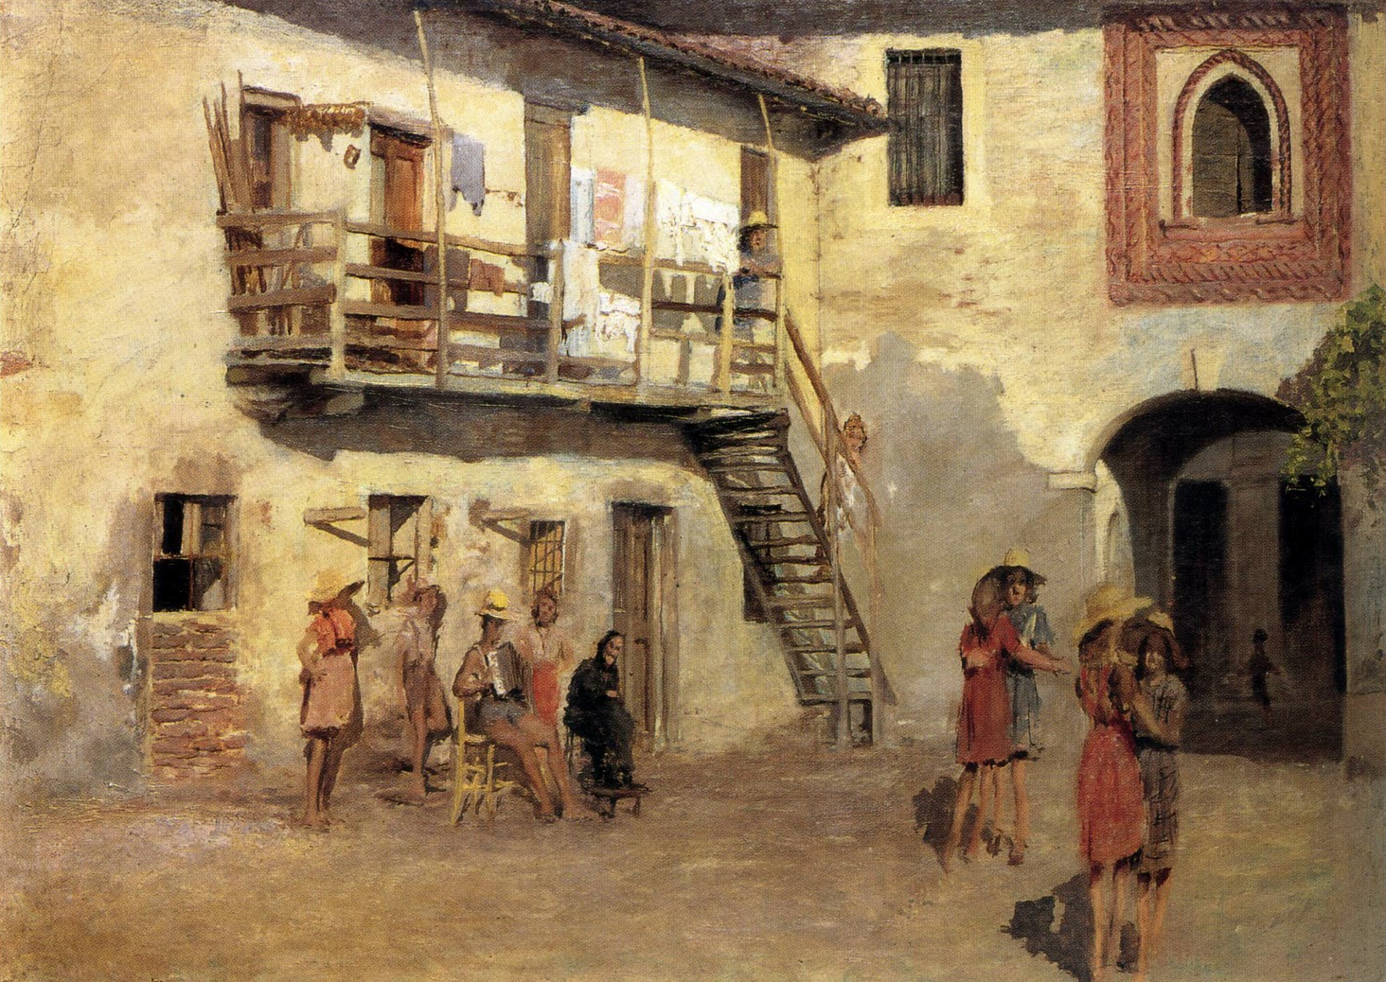
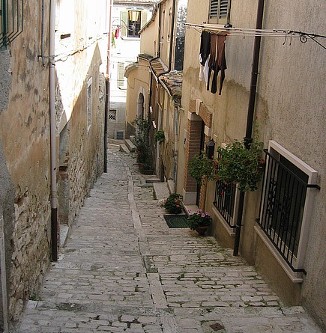
The courts
The most ancient rural settlement
• Small complex
of urban houses.
• Generally the courts were built near rural districts where people used to work.
• They surround an open-pit area.
• The single units are mainly composed of one level or two overlapped. An arcade supports large terraces.
• Thought to contain more than one family in one single area.

Slide 5
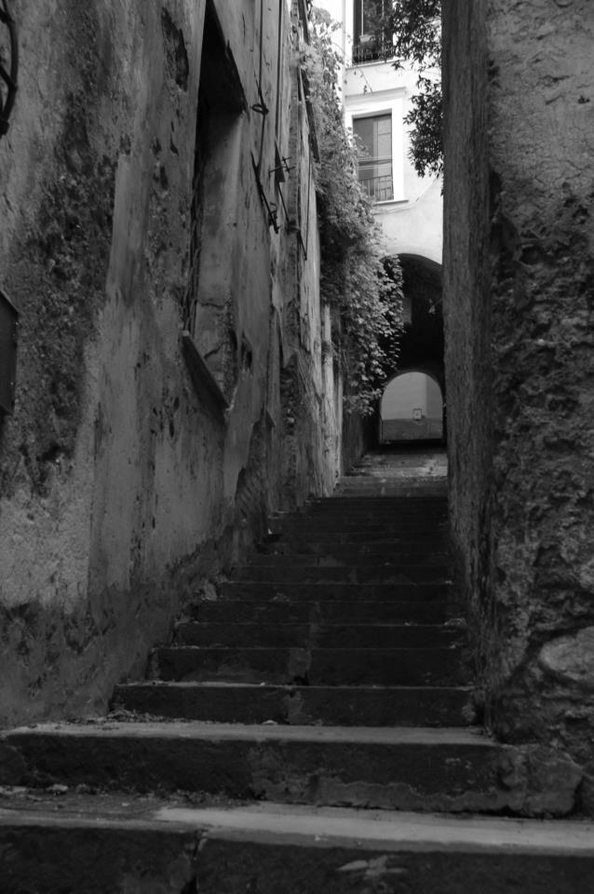
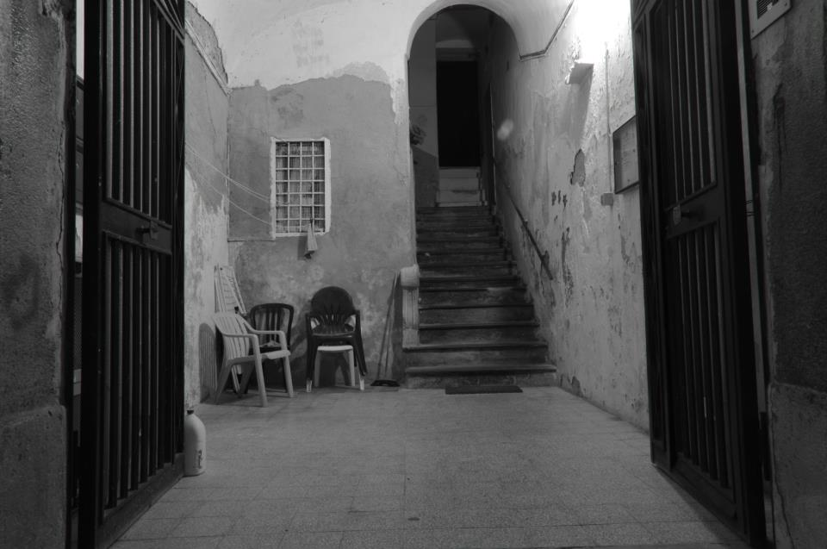
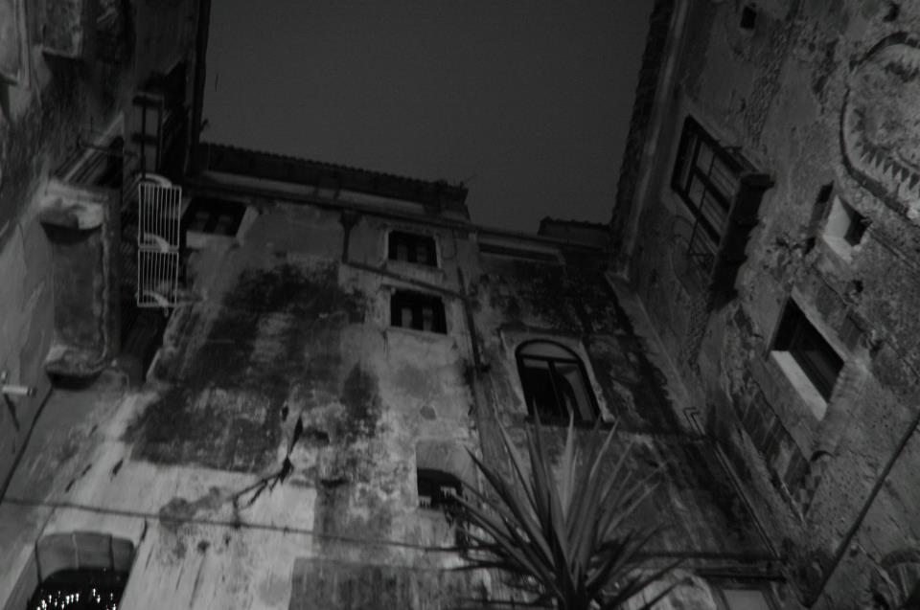
• The way of connecting the houses depends on how much space there is and on the most suitable position for the construction.
• Material: the most common and cheap was tuff.
• Structures: domes, huge arches that sustain galleries and stairs that connect the levels.
• Colours : white of plaster, grey of tuff and finally red of the roof tiles.
• There is a sort of hierarchy among the functions:
Position | Function
The biggest room is close to the street. | Loading and unloading/ social life.
Other small rooms are inland, in rural areas. | Livestock and agricultural activities.

Slide 6
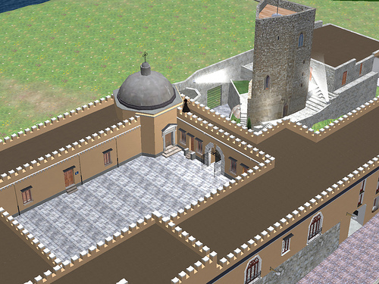
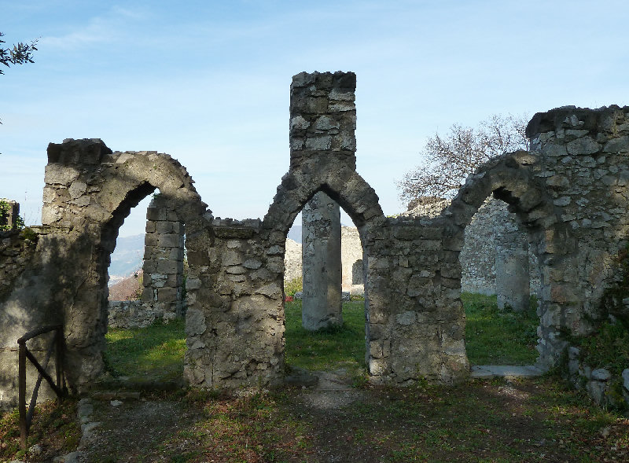
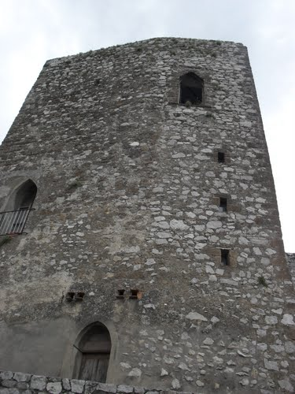
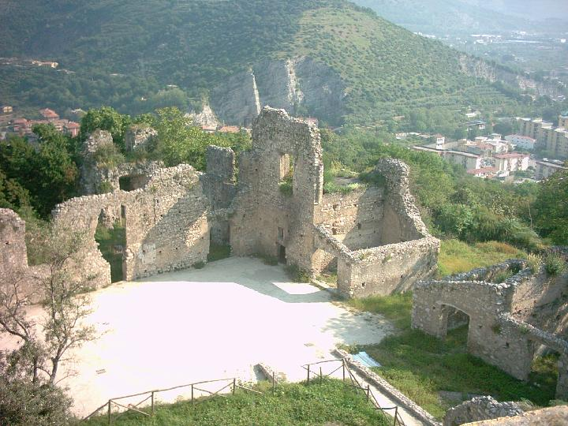
Fienga Castle
The structure of the castle is surrounded by three walls and at the top of them a Norman-Svevian tower was built. Interesting are the double lancet windows.
The actual structure was built between the 19° century and 20° century and takes its name from the last owners who lived there till few decades ago.

Slide 7
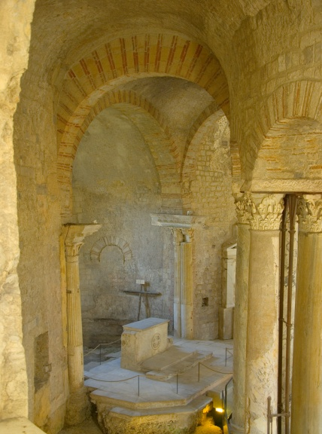
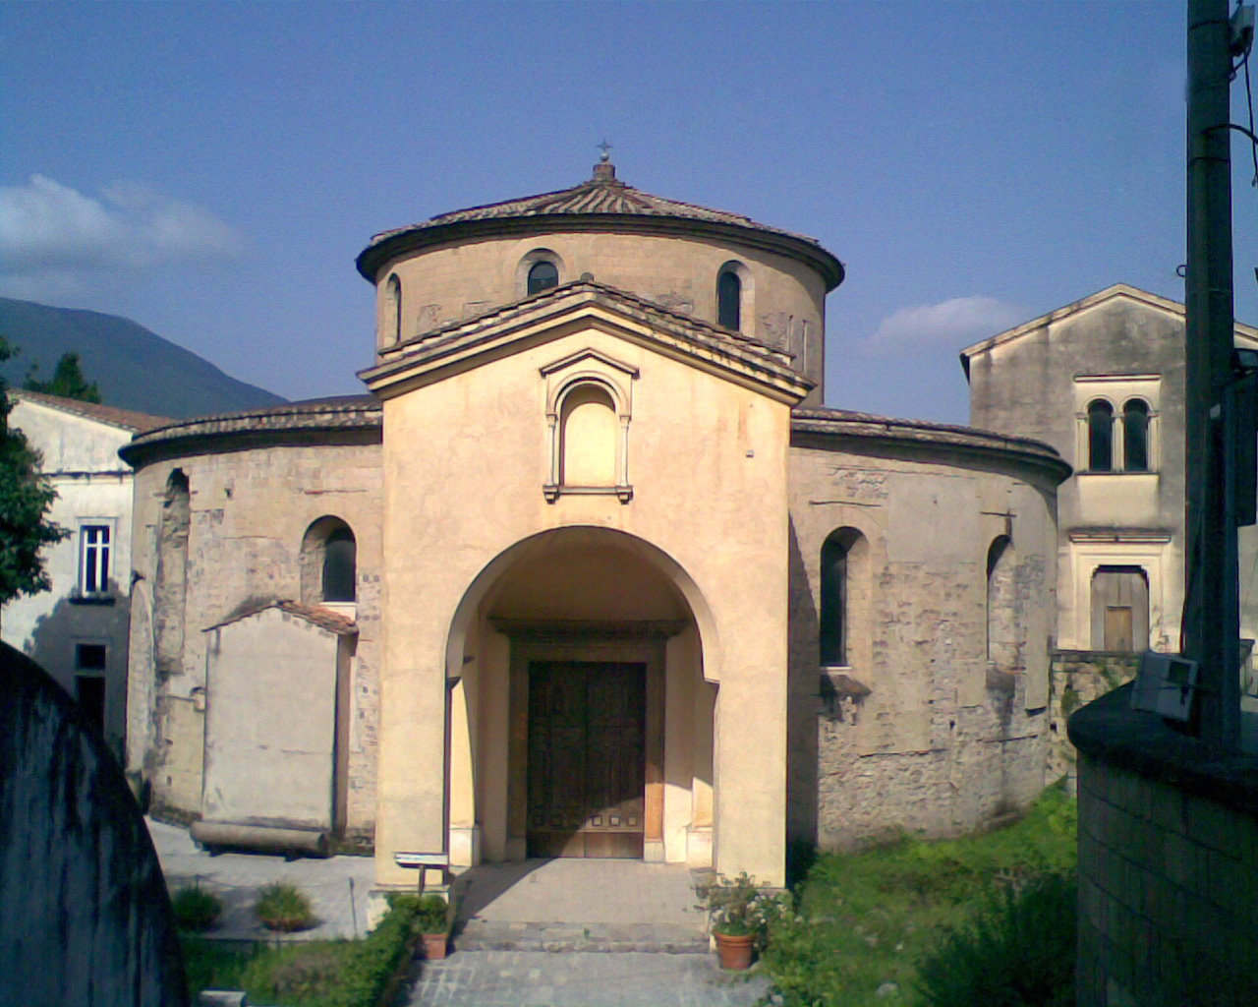
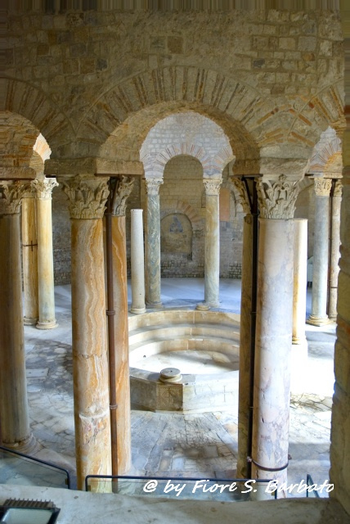
“The Paleochristian Baptistery”
in Santa Maria Maggiore
Where: The Baptistery is situated in the centre of the present town.
When: It was built around the middle of the VI century A.D. over the ruins of an Imperial building and was part of a larger and sacred structure.
Structure: Circular shape with a marble baptising basin found in the centre, surrounded by fifteen pairs of precious marble columns.
Nocera Superiore

Slide 8
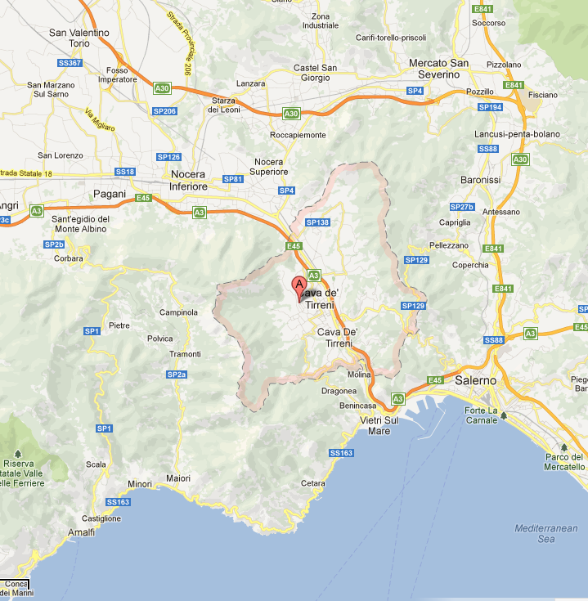
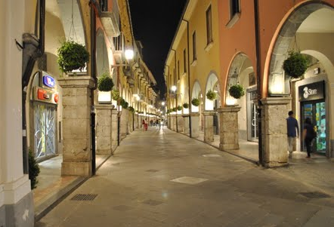
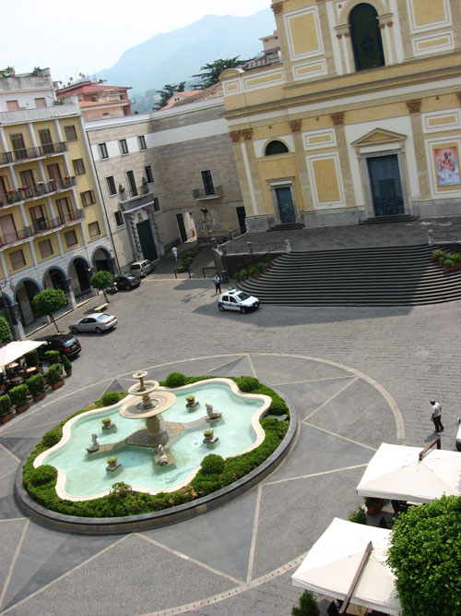
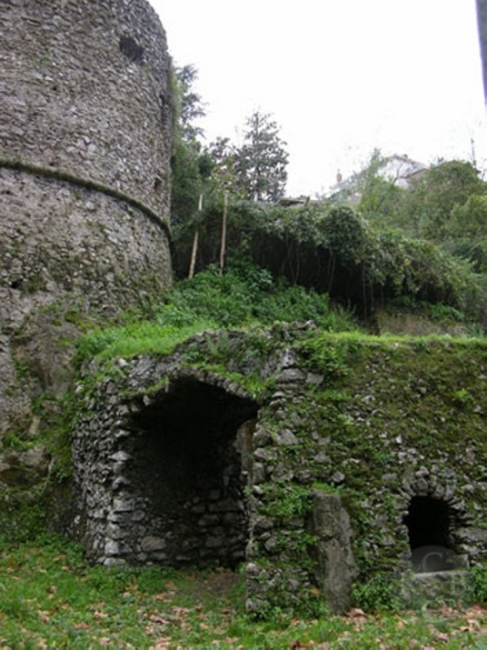
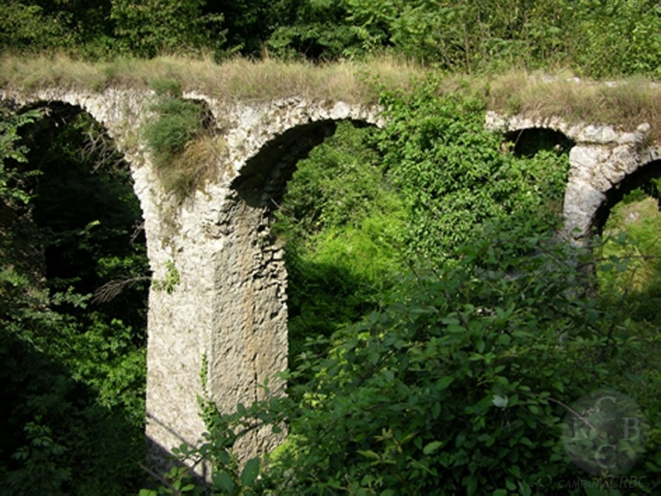
Cava de’ Tirreni
Cava de’ Tirreni is immersed in a sea of Mediterranean vegetation.
• At the beginning, the abbey was born then the convents and the churches.
• The Roman presence in the area is easily recognisable: arches, aqueducts and cisterns.

Slide 9
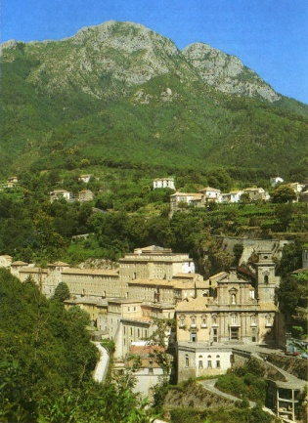
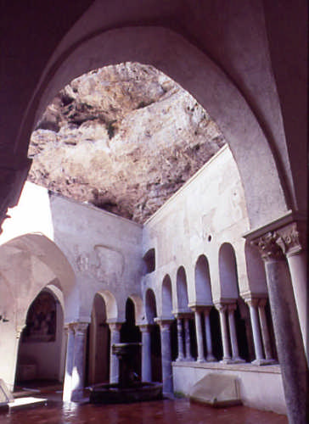
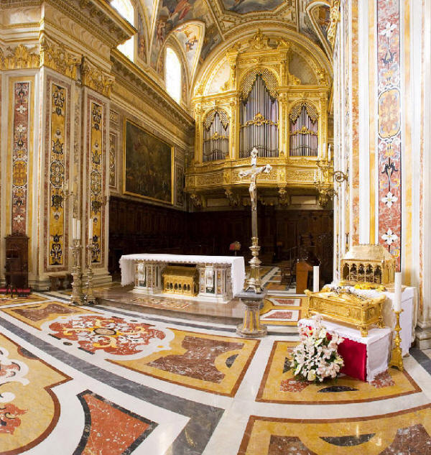
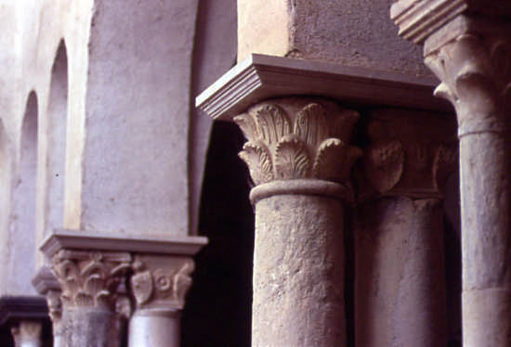
Our itinerary to discover the city of Cava goes on.
Visit to a mystical and secluded place:
Badia della Santissima Trinità
Where: It stands at the foot of Monte Finestra.
• The dome, the choir and the traverse were frescoed in the 19th century. Interesting are the pulpit, two bas-reliefs, the altar in multicoloured marble, the Romanesque cloister, the vast hall and the library.
When: It was founded in 1011. The current facade dates back to the second half of the 18th century.

Slide 10
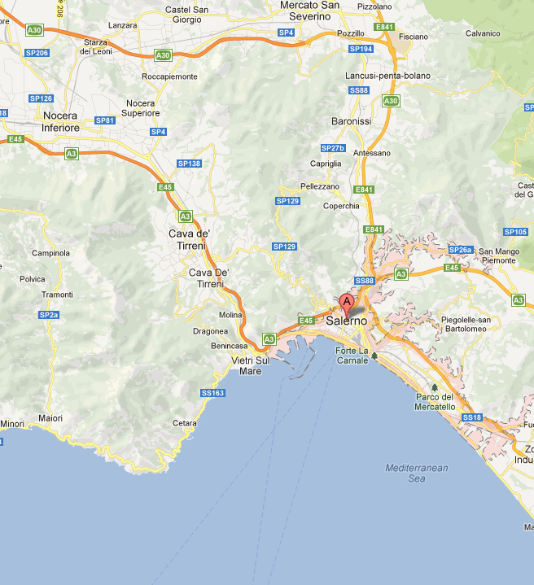
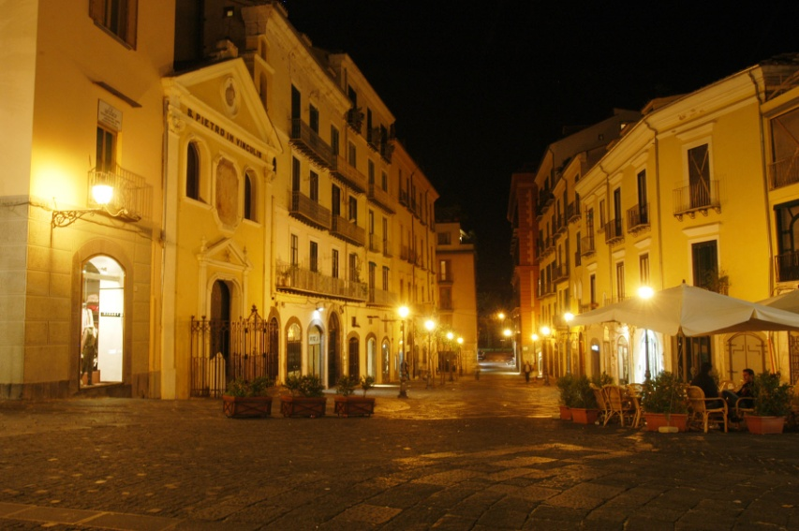
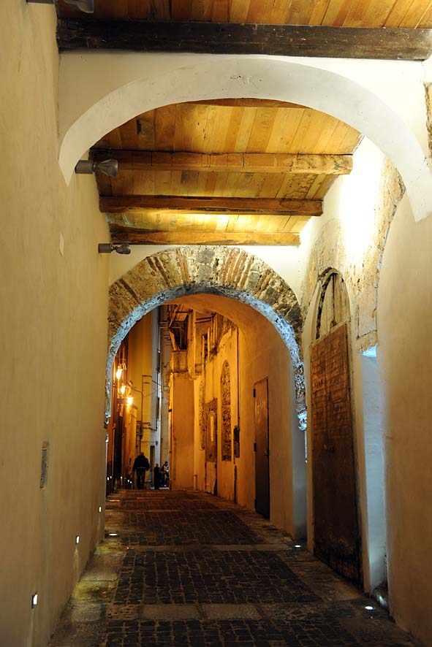
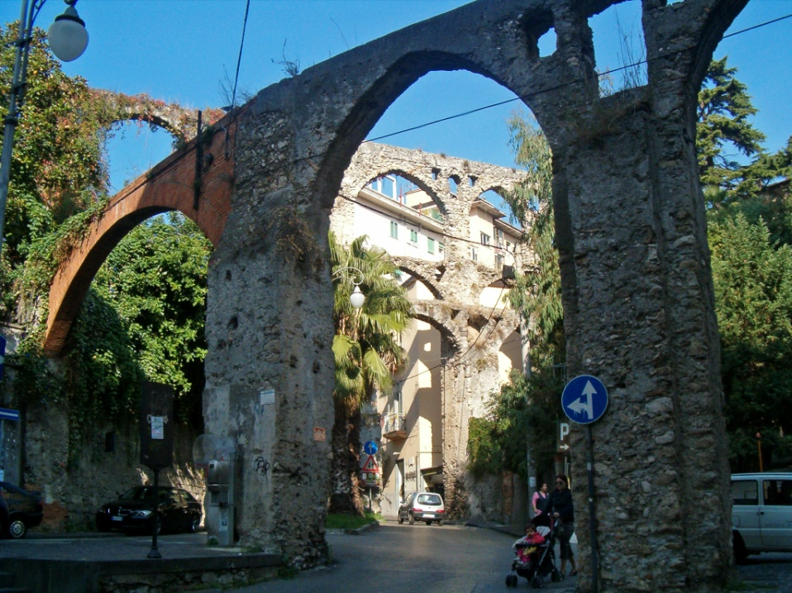
Salerno
• The heart of the city is the medieval quarter: “Merchants’ street” characterized by narrow streets and beautiful historical buildings.
Salerno is the main town close to the Amalfi Coast. It was founded by Romans in 197 B.C., then by the Longobards and the Normans.

Slide 11
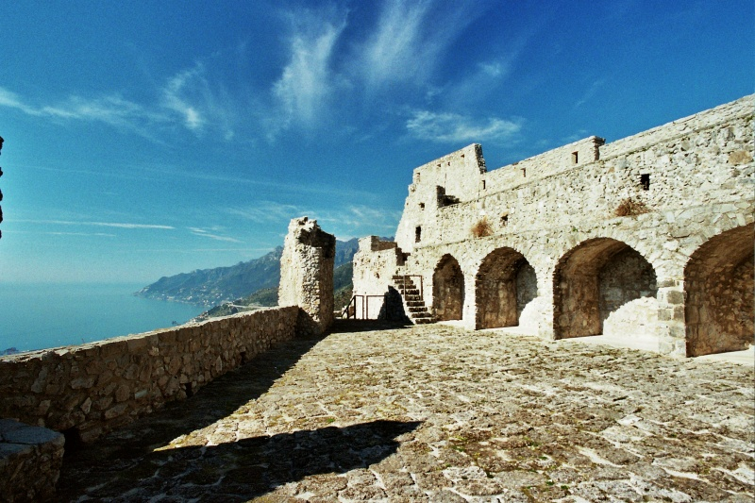
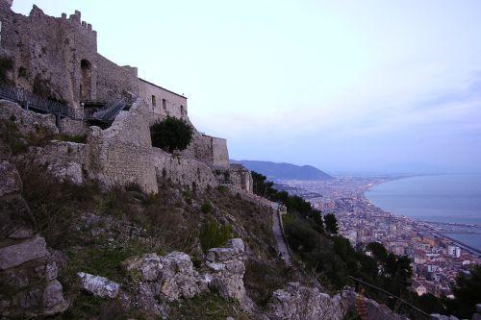
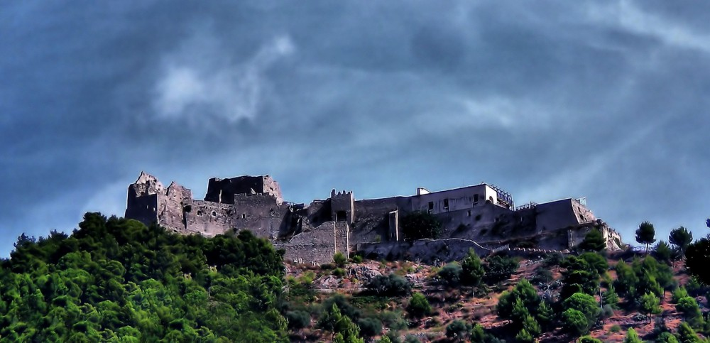
Arechi’s Castle
• How: It was built by modifying the old walls over pre-existent fortifications, dating back to the Roman and Byzantine period.
• When: VII century on behalf of the Lombard Prince Arechi II
• Why: it had a strategic position : dominating over the Tyrrhenian, presented significant access to the sea for the Princedom, from a commercial and defensive perspective.

Slide 12
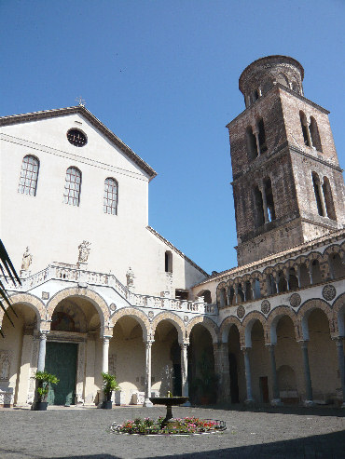
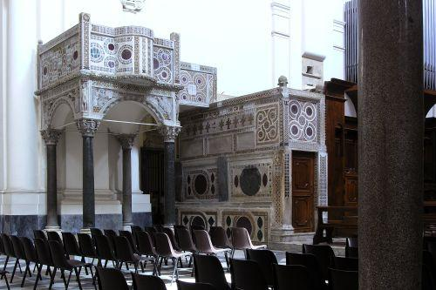
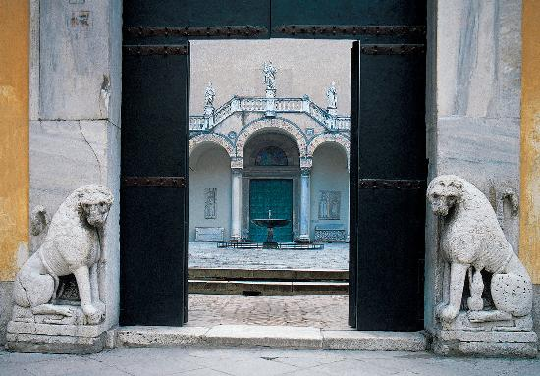
St. Matthew Cathedral
• It is a Catholic church, the most important monument of the city and a masterpiece of Norman architecture.
• The vast porticoed atrium has ancient columns, an elegant loggia and is dominated by an imposing Romanesque bell tower.
• The main entrance of the church consists of a bronze Byzantine front door.
• In the central nave one can admire the famous ambos decorated with sculptures and mosaics…

Slide 13
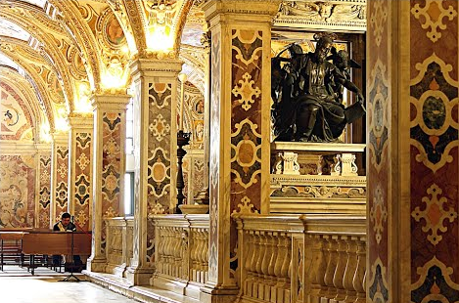
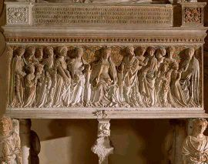
The level below contains the Crypt..
• The Baroque crypt is from the 1600’s,
covered in polychromatic marble.
There are also numerous funeral monuments.
• In the same year a double central altar
of Saint Matthew was created.

Slide 14
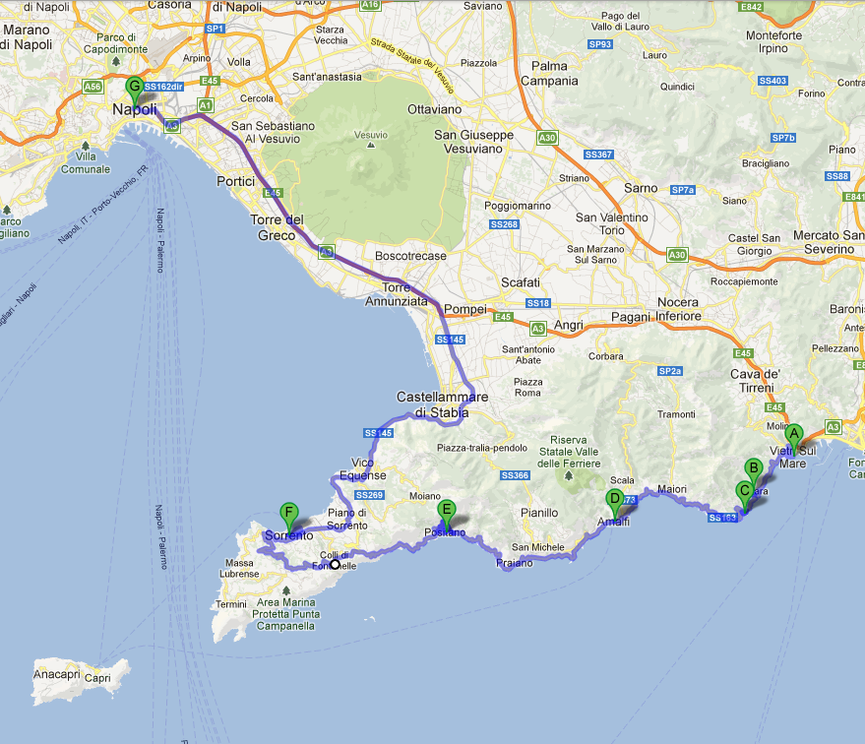
Wild, daring and romantic, the Coast is an obligatory stop in any journey to Italy - safely kept inside a treasure chest between Vietri and Naples.
Amalfi Coast
Discovering the enchanting

Slide 15
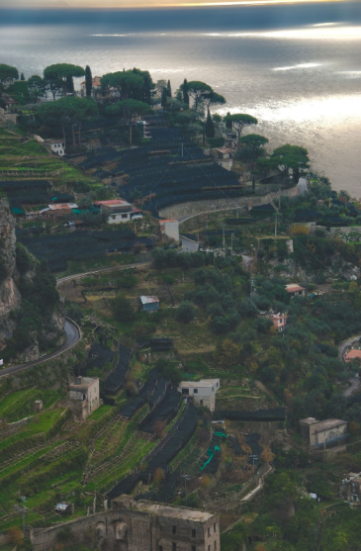
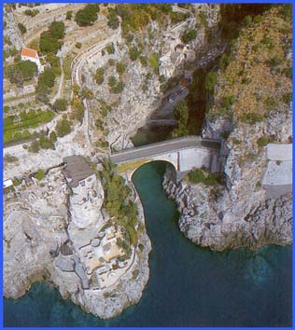
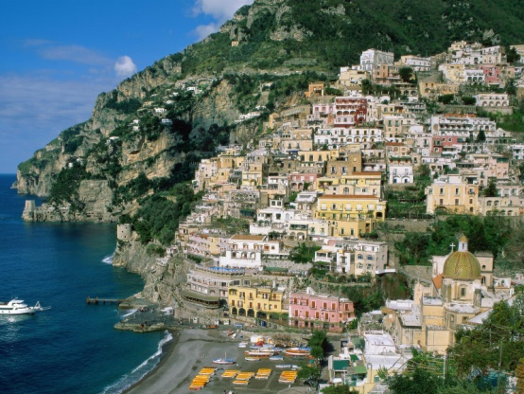
The urban structure of the districts
Coastal belt | Hill belt
The villages of this category are densely populated because of the vertical slope of the hill. The residential area rallies around a river or cleft. They seem cohesive, but are single units of the same area and are connected by stairs. | Given that the houses are at a higher level, there is more space for them to form. The hamlets occupy many layers so they are not cohesive. 1. Furore 2. Tramonti
2.
1.

Slide 16
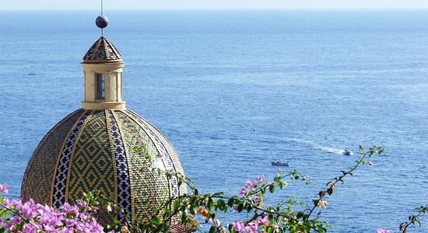
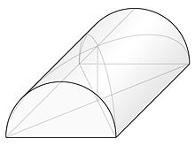
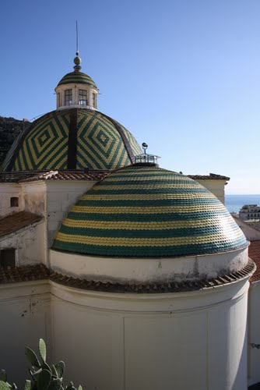
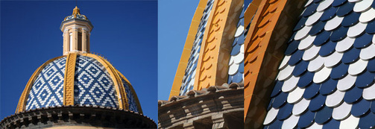
Dome house
• It is the most ancient structure of the Amalfi Coast.
• Origins: Arab, or even Byzantine-Greek.
• The most frequent shape was with rib vault
and barrel vault.
• The windows were always very little.
• Material: lime and stone (first layer).

Slide 17
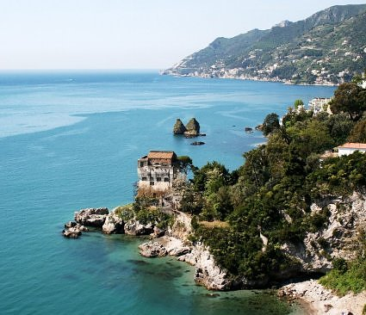
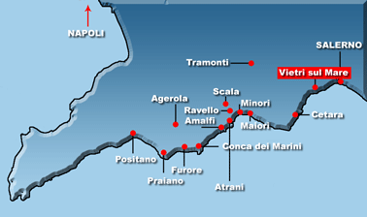
Vietri sul mare
Walking along the paths and climbing the centuries old flights of steps, you can enjoy the magic of this landscape and its panorama suspended between sky and sea..
• Where: Vietri is the door to the Amalfi Coast, facing the Gulf of Salerno.
• Origins: In ancient times it was Etruscan but later it was dominated by Romans.
• It is characterized by small churches, their majolica-covered domes, and the small tile-covered houses. The urban system is different from the other coastal villages because it is similar to that of Salerno.

Slide 18
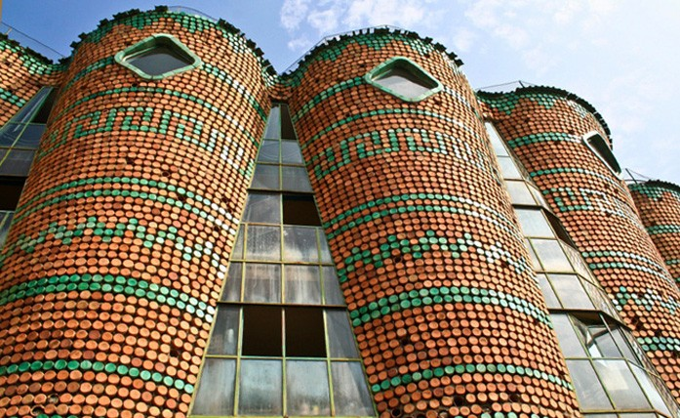
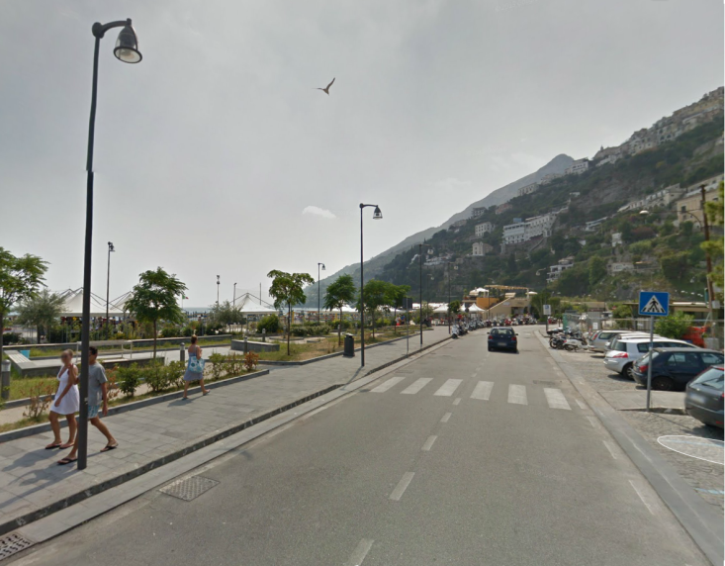
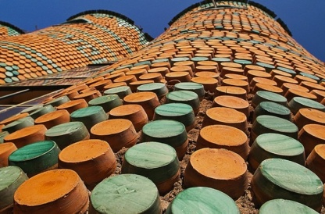
The district is divided in two levels:
1) The top one rallies around the main church (like the other coastal villages) but has a modern style.
In fact, there is the “Solimene” factory.
covered in unfinished and green enamel vases.
Vietri is renowned
for its
pottery.
2) The lower level called “Marina”, instead, is characterized by the sea, the houses are built in blocks and many of them are situated near the river.

Slide 19
Amalfi
• Together with Atrani, Cetara and Positano, it has a pyramidal structure.
• The homes, one on top of the other, are characterised by arched porticos that look onto the sea, and are painted in pastel colours, giving it the look of a multifaceted precious stone.
• Here the Cathedral dominates from the top of its majestic stairs. The imposing polychromatic façade of the church is impressive.

Slide 20
Positano
When you come to Positano, it’s worth bringing an empty suitcase. This is because you will return laden with all handmade souvenirs.
• It’s a waterfall of little multicoloured houses clinging onto its sides. Positano is called “the gem of the divine coast”.
• The narrow streets, lined with boutiques, run downhill between
the houses.
The great
coloured majolica
cupola is visible
from all over the town.

Slide 21
Erchie
It opens on the sea. And lays on a vast area. “Minori” and “Conca dei Marini” have a very similar structure.
The houses overlook the small beach and surround the church of the village. It is similar to “Praiano”.
Maiori
Villa Cimbrone:
• The complex, made up by the main building and its centuries-old park, goes back to the 19th and 20th century. When the English esthetic Ernest W.Beckett bought it, reached the peak of its beauty: gardens, fountains, statues and pavilions as a typical “villa romana”.
Ravello
The houses are disposed along the hill at different levels. The Cathedrals are the heart of this village. It is similar to “Scala”.
Villa Rufolo:
• Immersed in a verdant park of Mediterranean flora, the original structure dates back to the 13th century. The garden creates a highly evocative atmosphere thanks to the lime trees, cypresses and cascades of flowers.

Slide 22
Hotel Palumbo
Ravello
• The “Confalone” Palace dates back to the 12th century. The architecture has both Arab and Eastern influences.
• Inside, there are gothic arches that support ancient marble columns.
• Outside, creepers surround the rooms.
• The restaurant is situated in a room of the 18th century with vaults decorated with frescoes and antique earthenware tiles.

Slide 23
Back to urban structure, during ducal age residential areas were divided in
smaller units called “Rioni” (districts). These are typical of Naples.
Naples
Origins: They are lost in time and charming legends-9th century BC when the Greeks colonised the Gulf.
Before Italy was unified, Naples was under the Bourbons.
Naples, capital of the south for more than 600 years, remains the heart of this formidable area.

Slide 24
“Rione Sanità”
In “Rione Sanità” (literally "Health Alley“) is a famous neighborhood in Naples.
Where: It is located north of Naples' historical centre.
History: The settlement in Rione Sanità was originally established as a home for noble and rich families of Naples' aristocracy.
You will find yourself in its bustling narrow alleys. It bursts with colours, music, sights and scenes of everyday life.

Slide 25
Our journey goes on.. the historic core:
Spaccanapoli
Spaccanapoli is the straight and narrow main street that crosses the old, historic center of Naples.
The name is a popular usage and means, literally, "Naples splitter".
It is 1.2 miles
long and from above it seems to divide that part of the city.
Here you can browse in the little shops full of antiques, religious objects and jewelry..

Slide 26
Construction began in the early 1600’s.
Piazza del Plebiscito
Piazza Plebiscito is one of the largest squares in the heart of Naples.
In the centre of the square the two great statues of Charles of Bourbon and Ferdinand I on horseback face the Royal Palace.
It is characterised by the profile of the “San Francesco di Paola” Church, with its neoclassical colonnade and its interior inspired to the Pantheon in Rome.

Slide 27
Maschio Angioino
The impressive fortress, on which work was begun in 1279 by Charles I of Anjou, has trapezoid base and is surrounded by a moat where the foundations of the five cylindrical towers stand.
The Triumph Arch marks the entrance to the castle and is its main ornament.

Slide 28
Castel dell’Ovo
The profile of the coast is dominated by this massive Castle,
the oldest in the city.
Now connected to the land by a small bridge, the island was chosen by a Roman patrician as site for his new villa.
Transformed into a convent, became a fortress under the Normans.
From the high part of the castle you can enjoy a marvellous view of the gulf.

Slide 29
End your tour and relax..
Thank you for joining our unforgettable experience in Campania, Italy..
May 2013

Slide 30
Liceo Statale Alberto Galizia
Nocera Inferiore, Salerno
May 13-15-2013
Arrivederci!

